Slide 1
Statistical Model

Slide 2
Joint 2
…
Trial
Joint 1
Joint 3
Joint m
Timepoint 1
Timepoint 2
Timepoint 3
Timepoint 4
…
Timepoint n

Slide 3
Joint 2
…
Trial
Joint 1
Joint 3
Joint m
Timepoint 1
EP
Timepoint 2
Timepoint 3
EP 1
Timepoint 4
…
EP 2
EP 3
Timepoint n

Slide 4
Joint 2
…
EP
Joint 1
Joint 3
Joint m
Timepoint 1
Timepoint 2
Timepoint 3
Timepoint 4
…
Timepoint n

Slide 5
Joint 2
…
EP
Joint 1
Joint 3
Joint m
Timepoint 1
Bins
Timepoint 2
Bin 1
Timepoint 3
Timepoint 4
…
Bin 2
Bin 3
Bin 4
Bin 5
Timepoint n

Slide 6
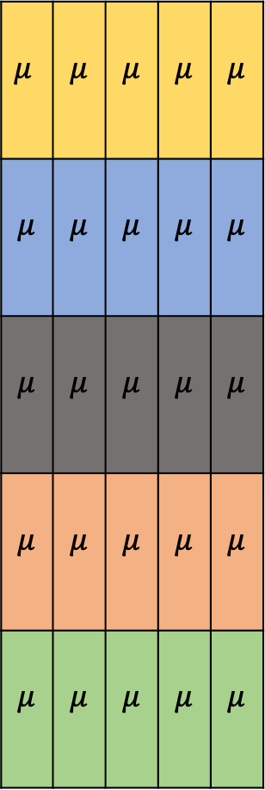
Joint 2
…
EP
Joint 1
Joint 3
Joint m
Timepoint 1
$$μ$$ | $$μ$$ | $$μ$$ | $$μ$$ | $$μ$$
$$μ$$ | $$μ$$ | $$μ$$ | $$μ$$ | $$μ$$
$$μ$$ | $$μ$$ | $$μ$$ | $$μ$$ | $$μ$$
$$μ$$ | $$μ$$ | $$μ$$ | $$μ$$ | $$μ$$
$$μ$$ | $$μ$$ | $$μ$$ | $$μ$$ | $$μ$$
Bins
Timepoint 2
Bin 1
Timepoint 3
Timepoint 4
…
Bin 2
Bin 3
Bin 4
Bin 5
Timepoint n

Slide 7
EP
Bins
Bin 1
Bin 2
Bin 3
Bin 4
Bin 5
EP 1
EP 2
EP 3
Joint 1
Joint 2
Joint 1
Joint 2
Each input to the classifier has a size of [number of bins X number of sensors]

Slide 8
Logistic Regression
Elastic Net Regularization (avoids overfitting)

Slide 9
Logistic Regression
Elastic Net Regularization (avoids overfitting)
Multinomial (predicts probability for each class)

Slide 10
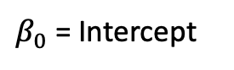

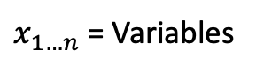
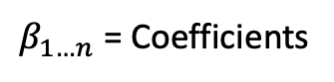
Logistic Regression
Elastic Net Regularization (avoids overfitting)
Multinomial (predicts probability for each class)
p(Class) = $\frac{1}{1+e^{−(β_{0}+β_{1}x_{1}+β_{2}x_{2}+…+β_{n}x_{n})}}$
$β_{0}$ = Intercept
$x_{1…n}$ = Variables
$β_{1…n}$ = Coefficients

Slide 11
Logistic Regression
Kinematic (cyberglove + Vicon)
EMG (Sessantaquattro)
Tactile
Multimodal (Kin + EMG, Kin + EMG + Tactile)
Hierarchical (Kin + EMG, Kin + EMG + Tactile)
Over number of bins
Over L1 vs. L2 regularization parameter
Over regularization strength

Slide 12
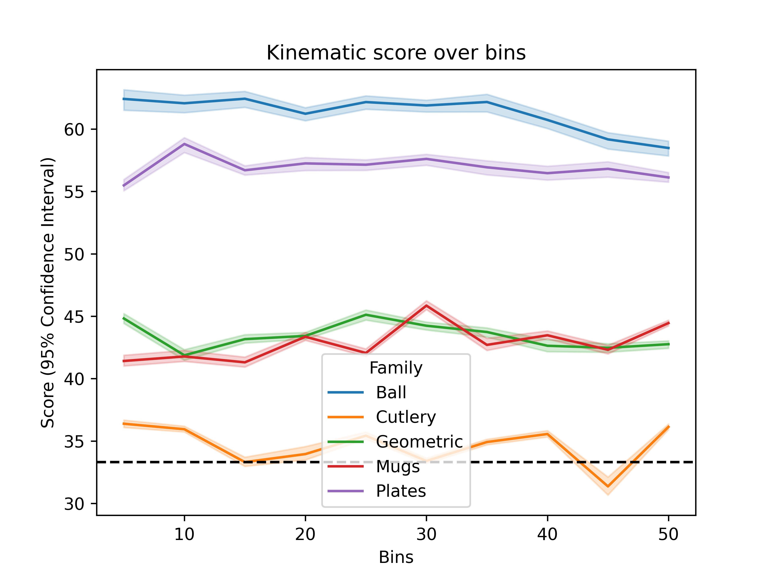
Kinematics

Slide 13
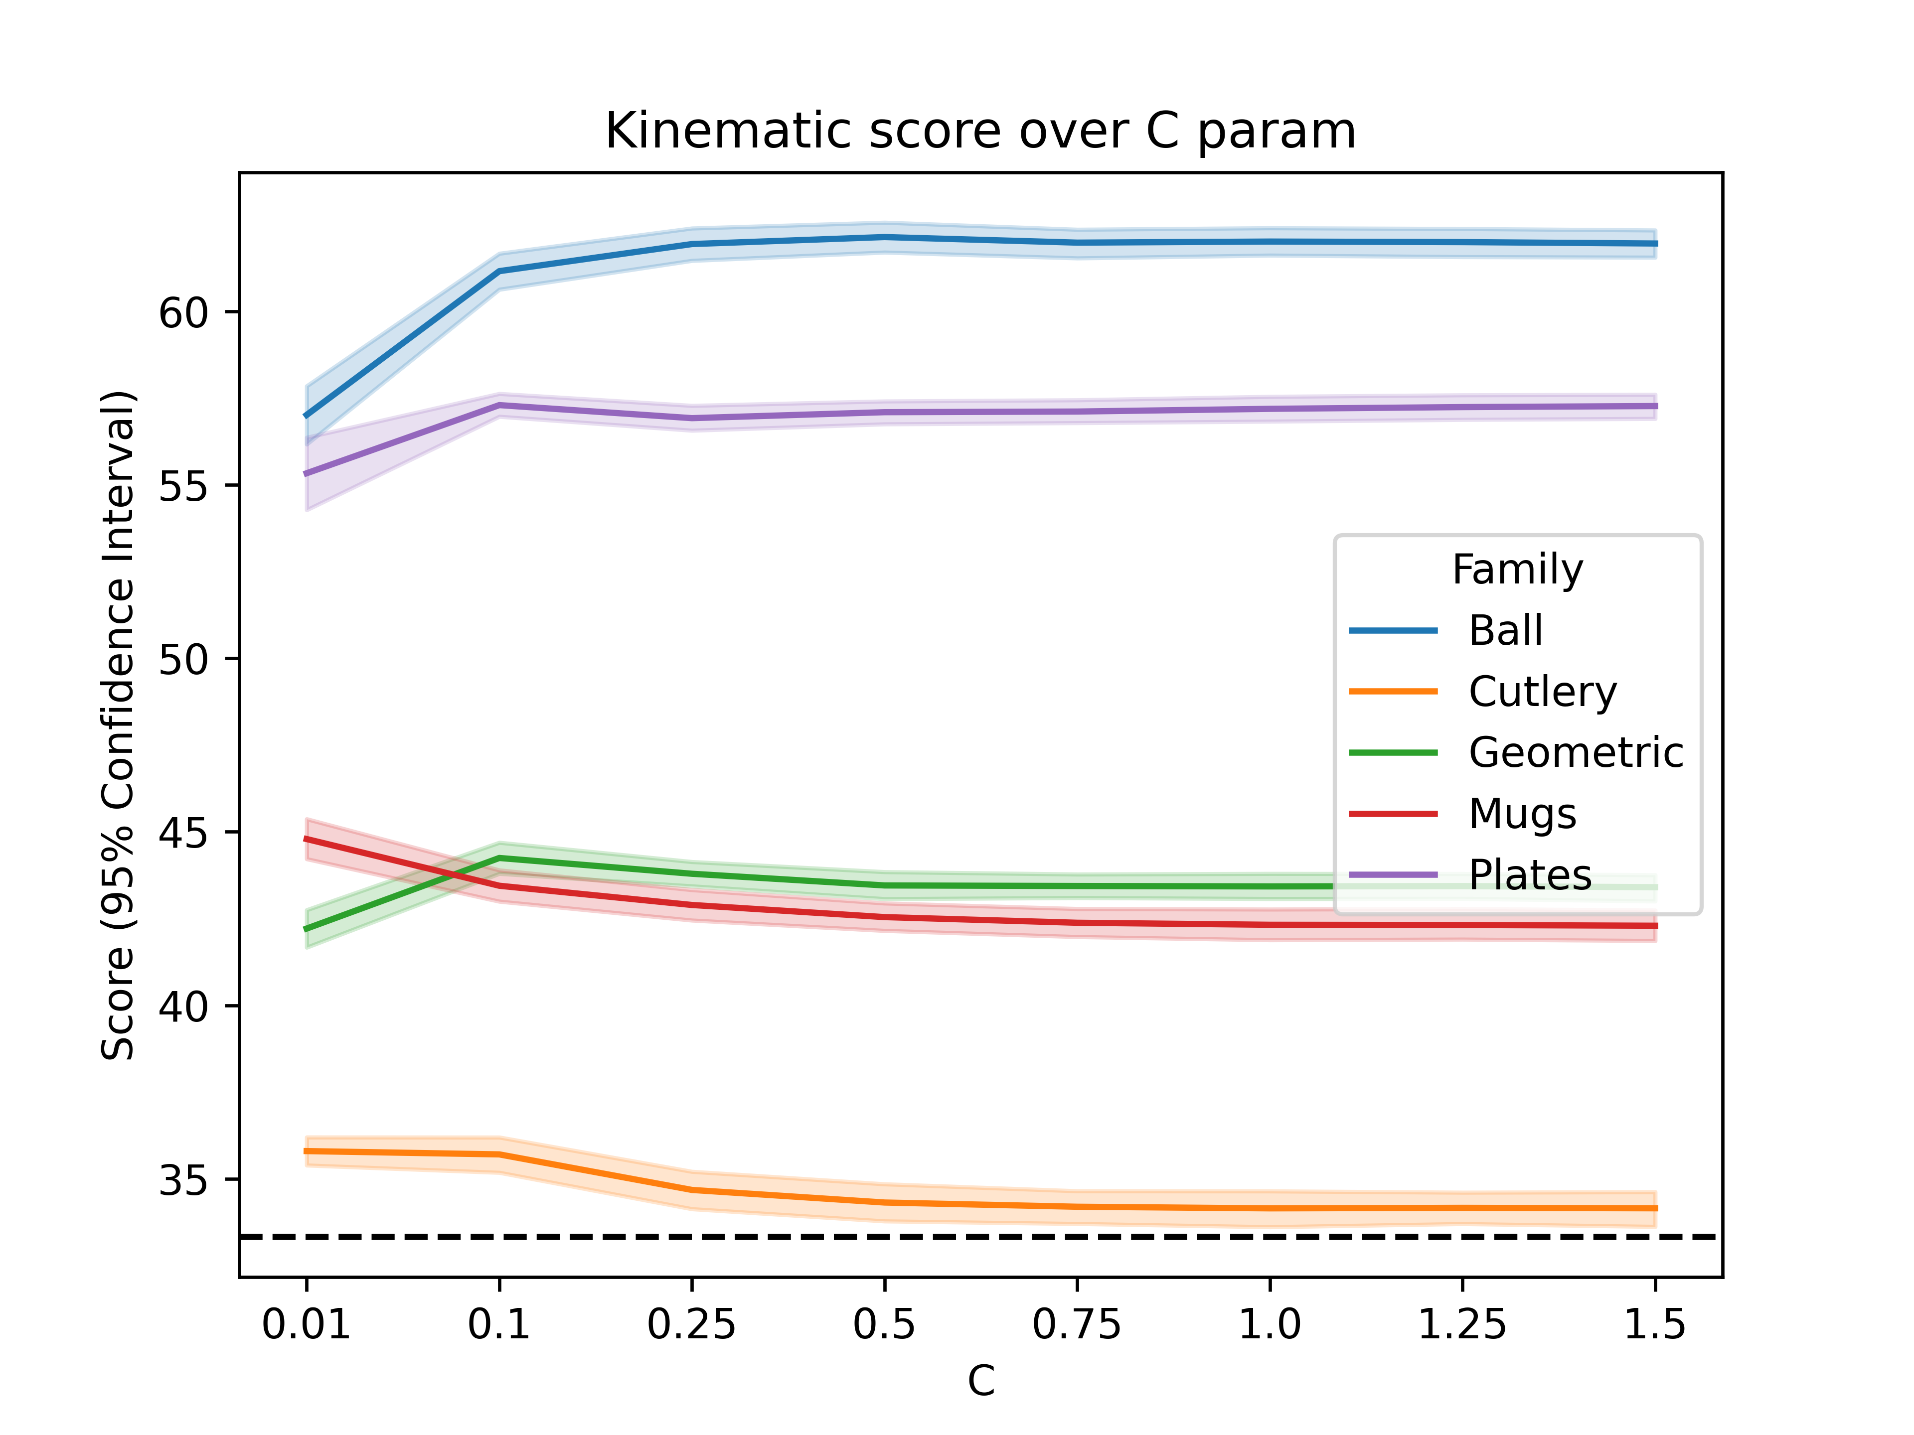
Kinematics

Slide 14
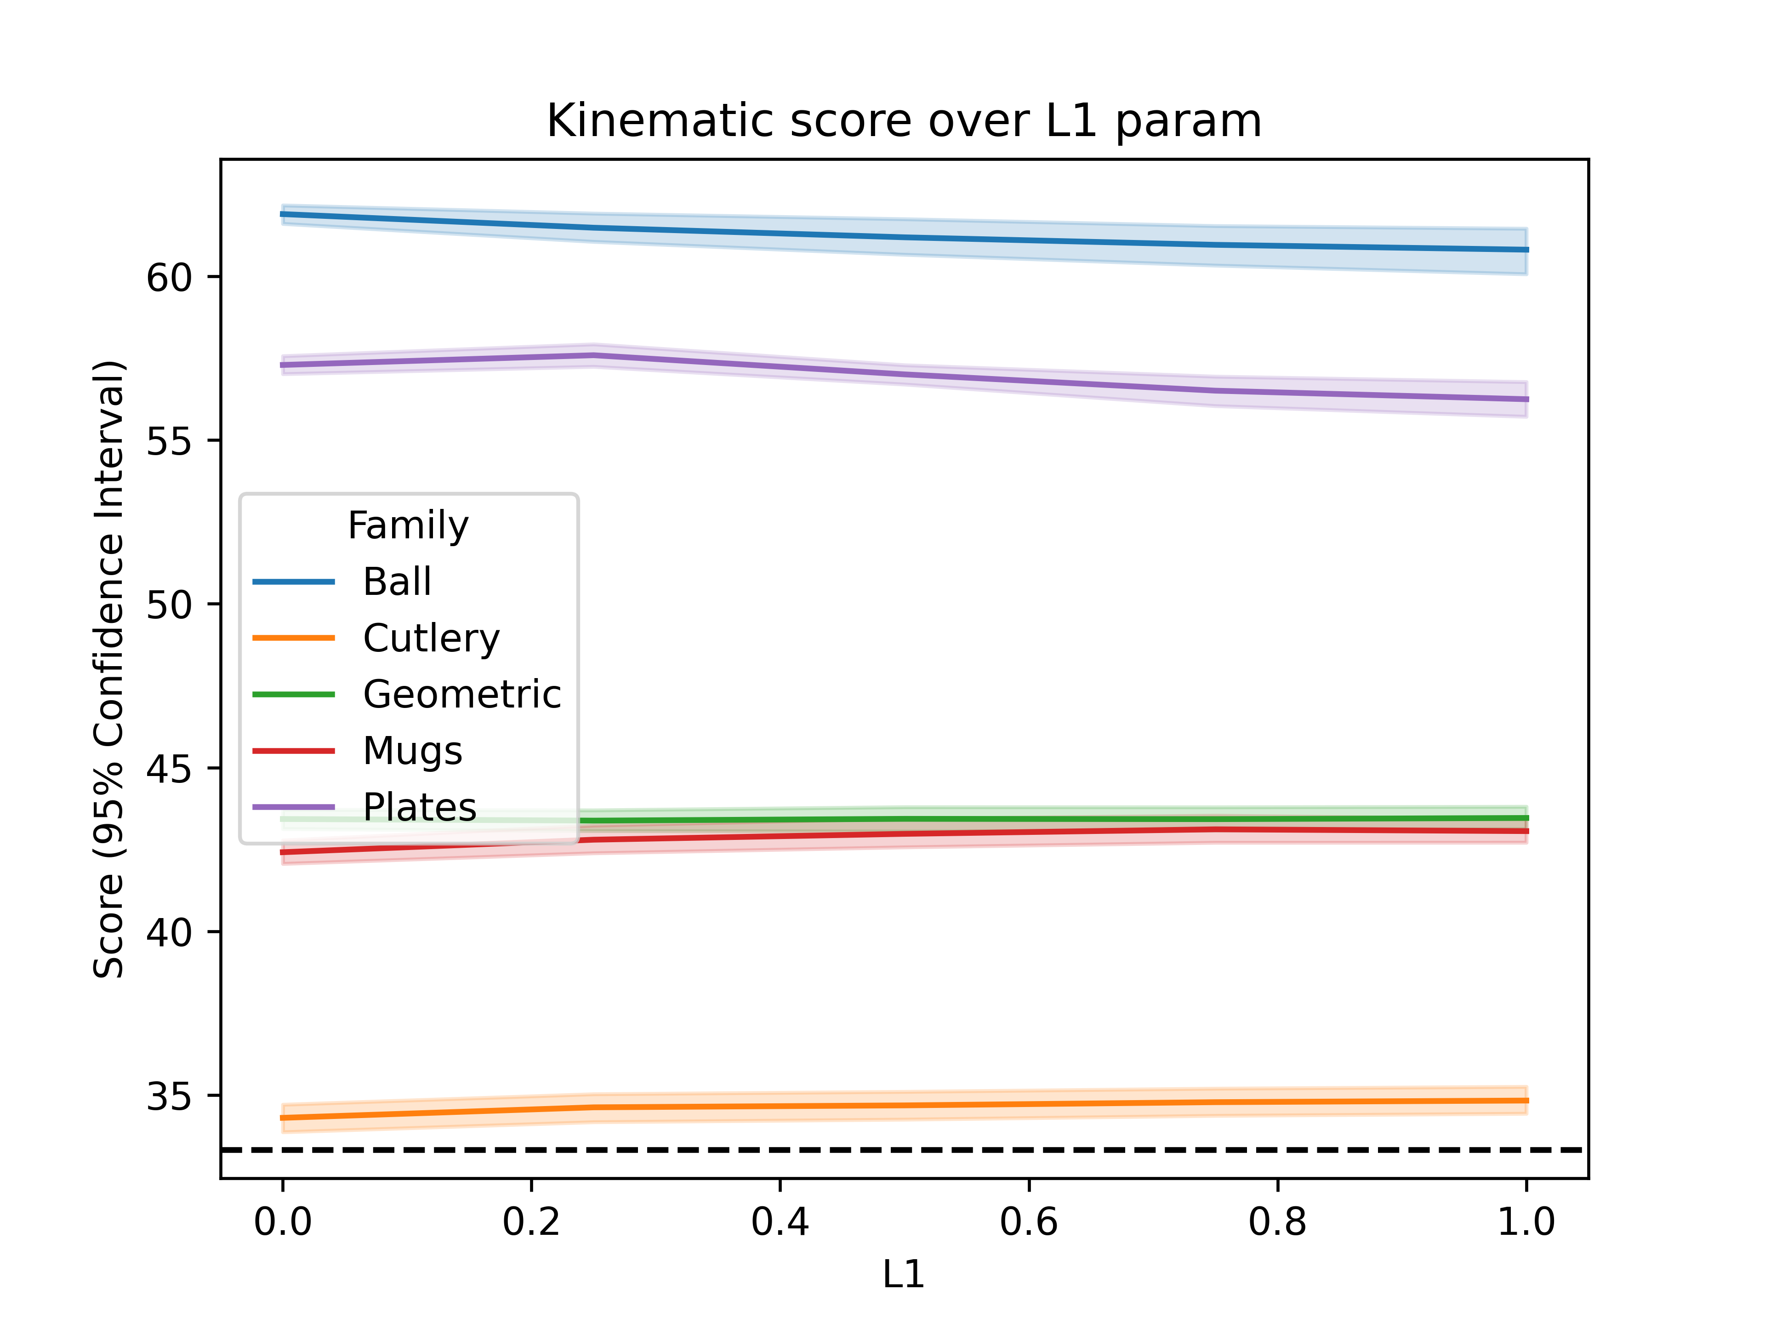
Kinematics

Slide 15
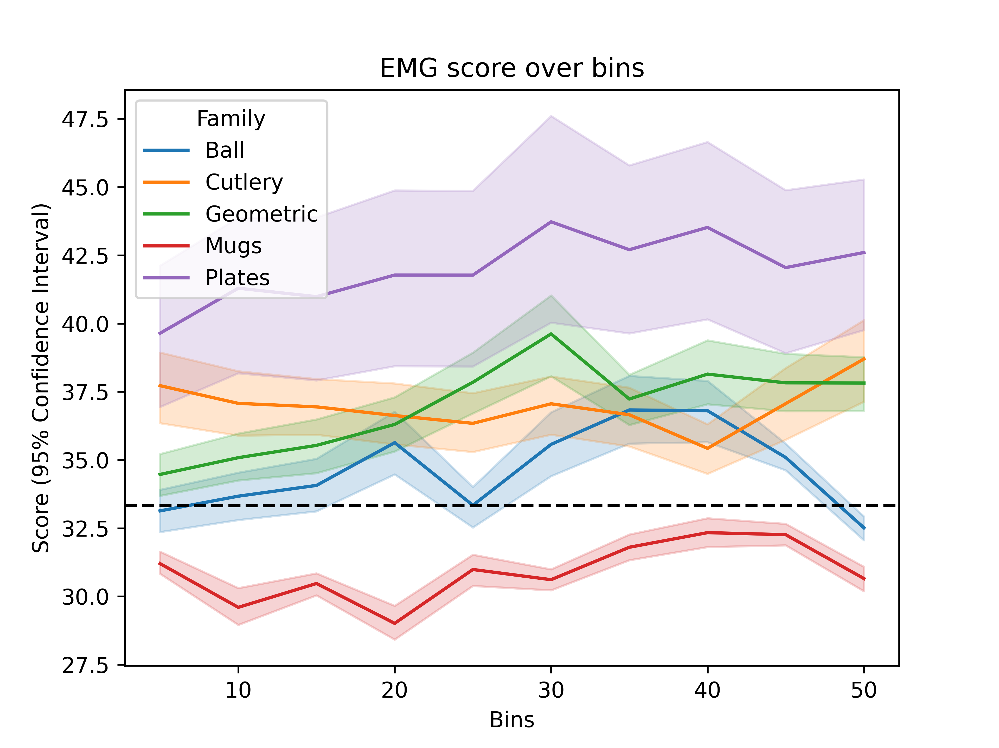
EMG

Slide 16
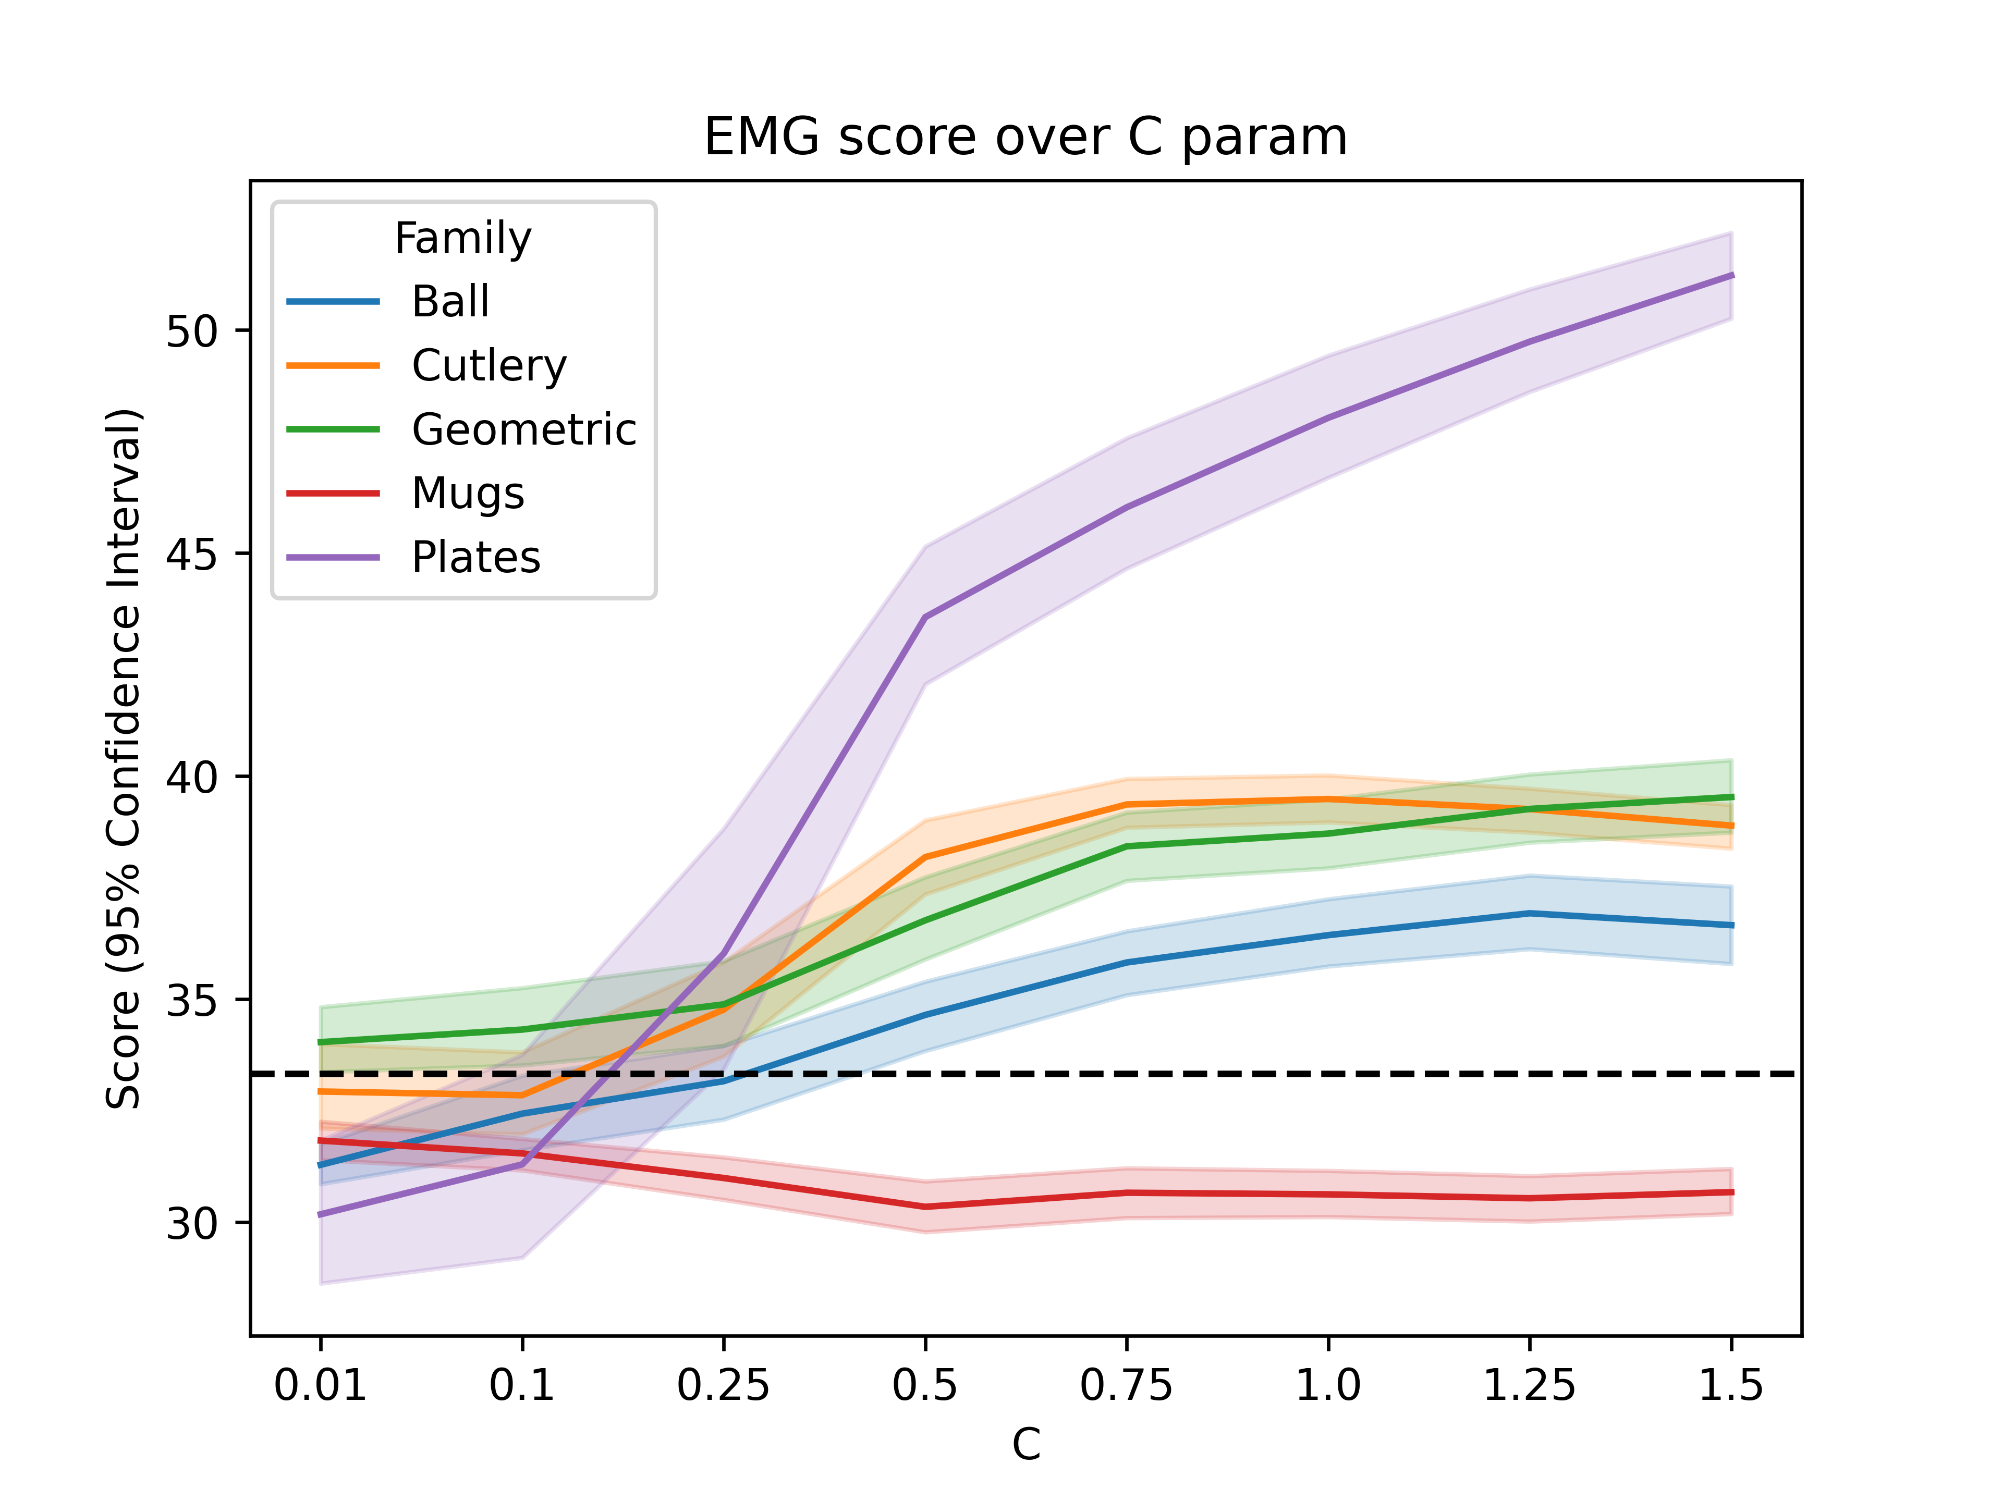
EMG

Slide 17
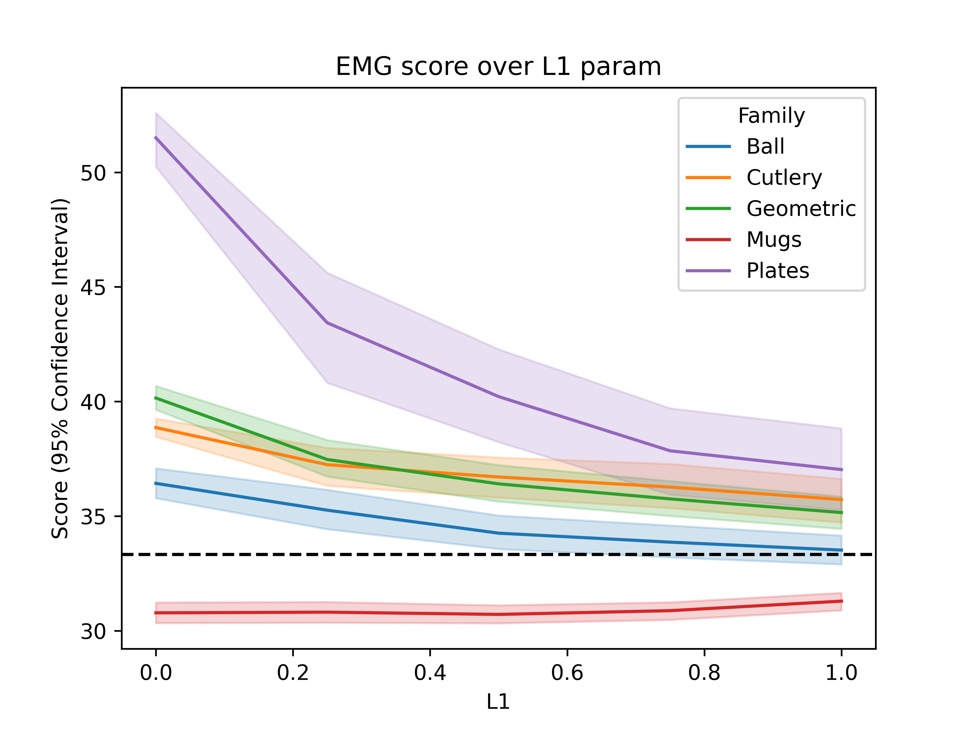
EMG

Slide 18
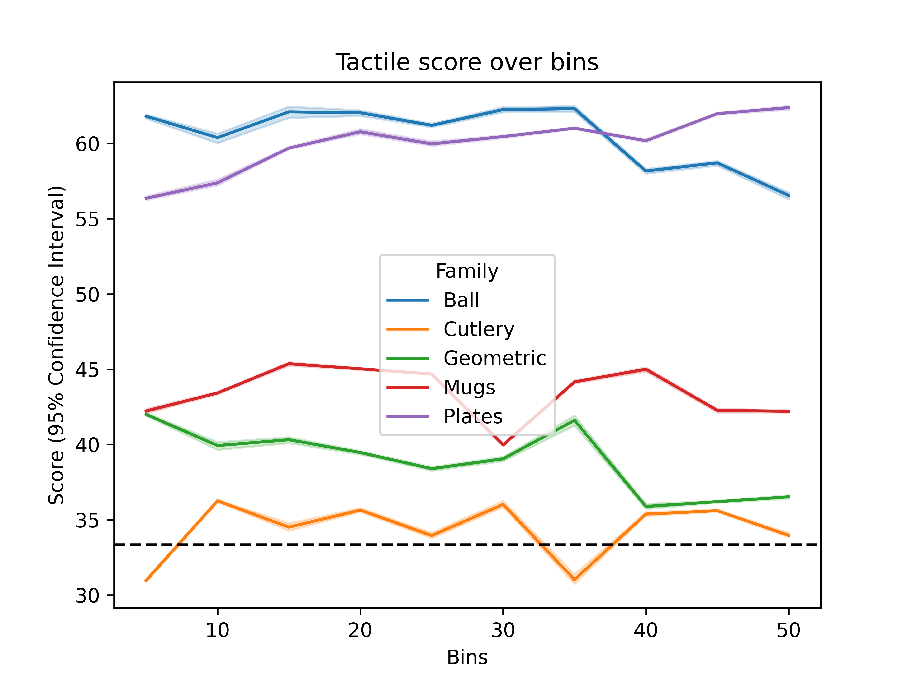
Tactile

Slide 19
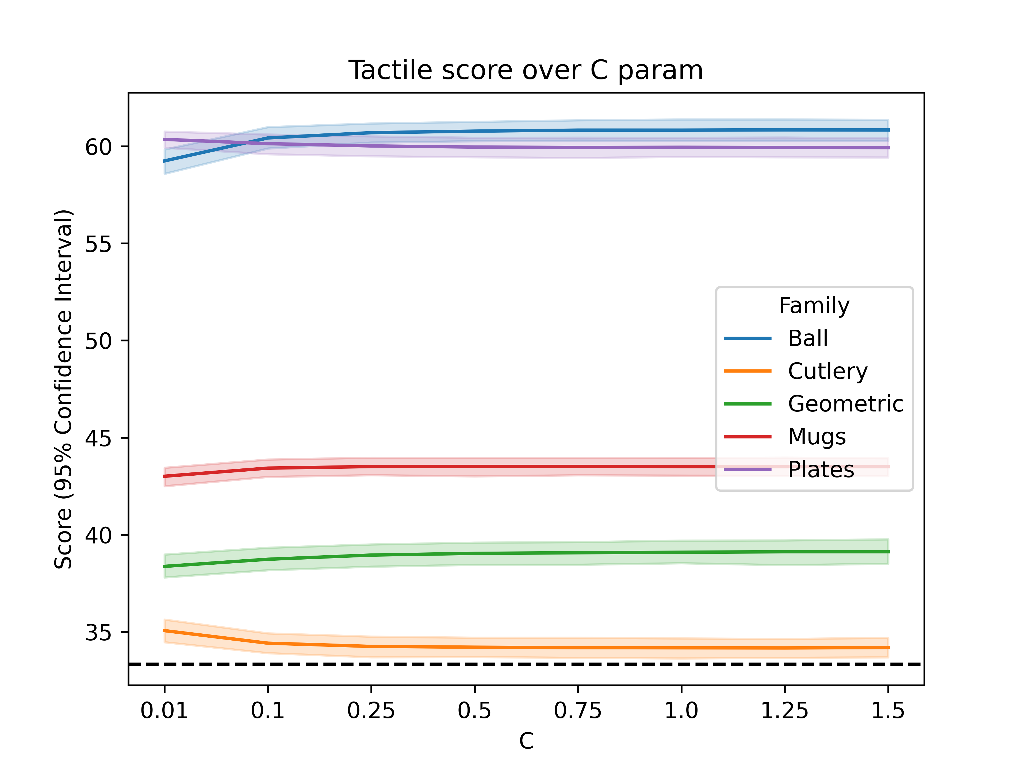
Tactile

Slide 20
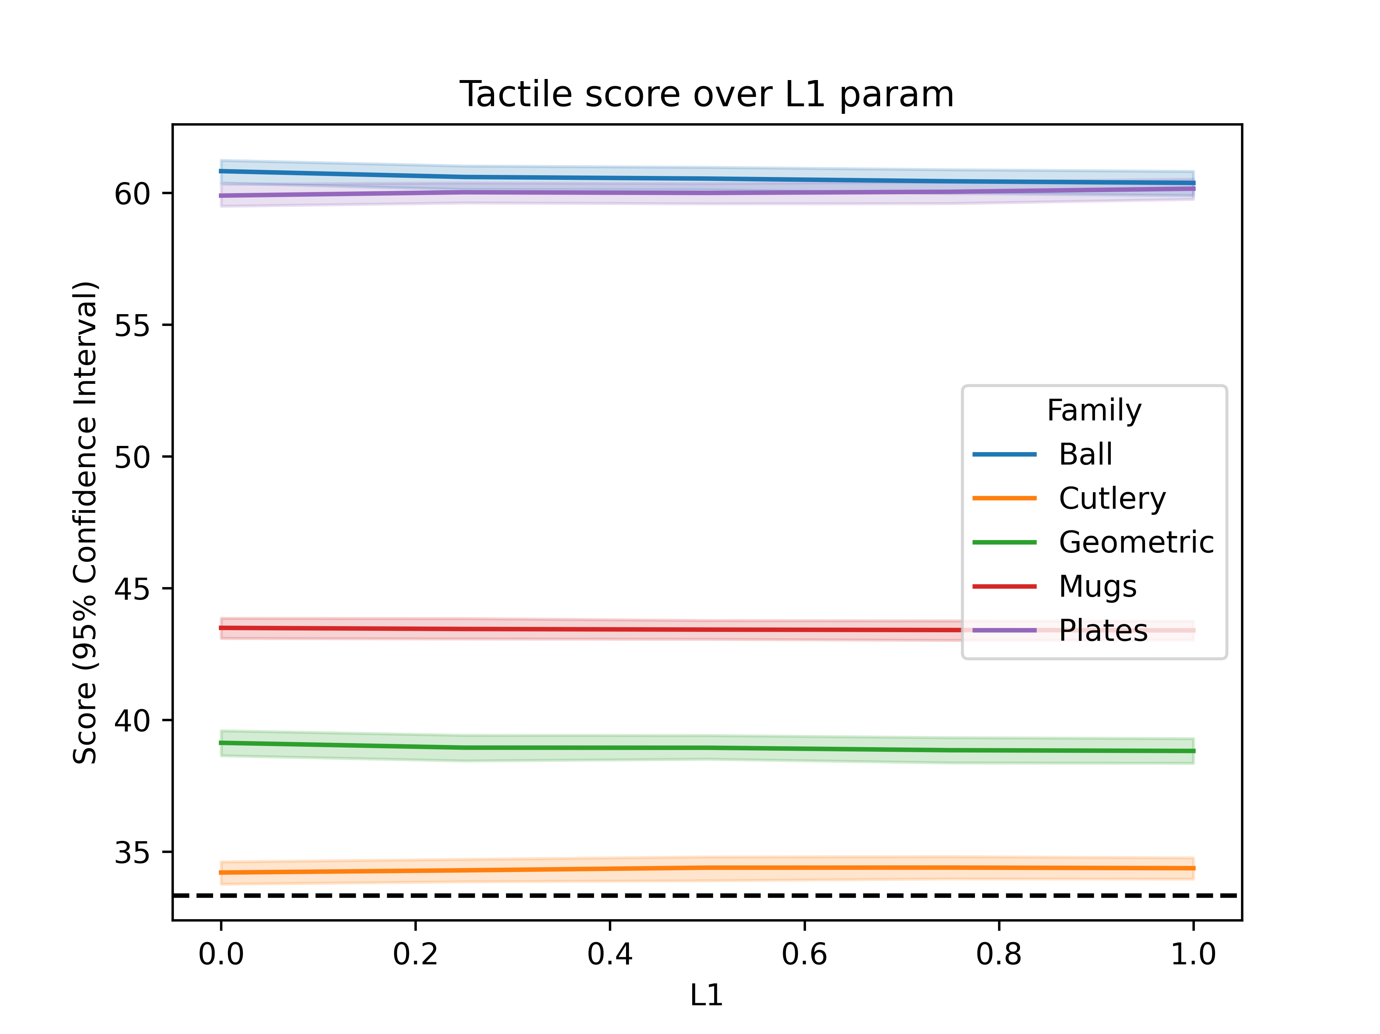
Tactile

Slide 21
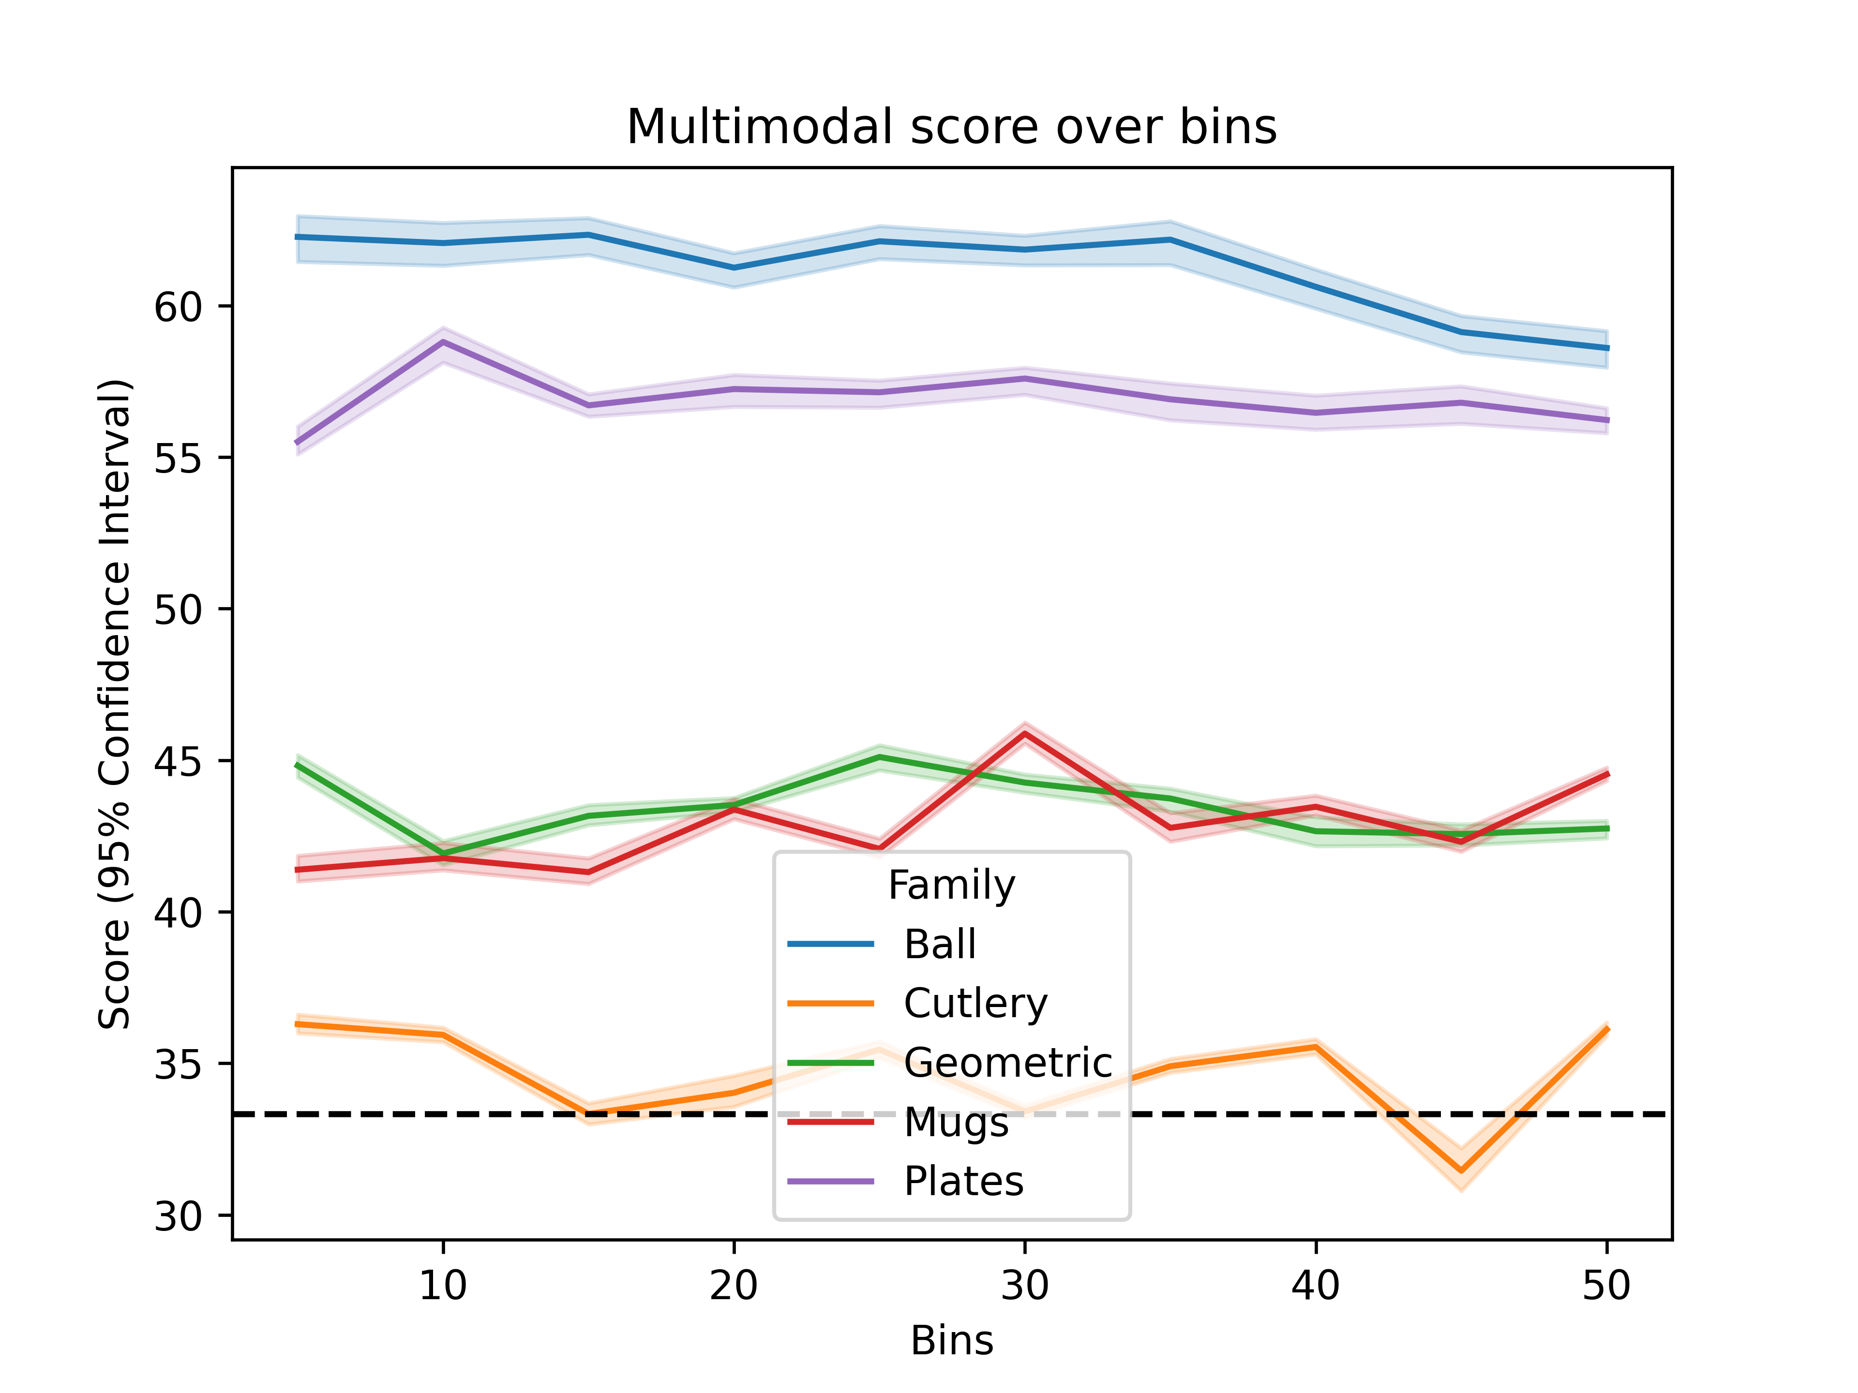
Multimodal (Kin + EMG)

Slide 22
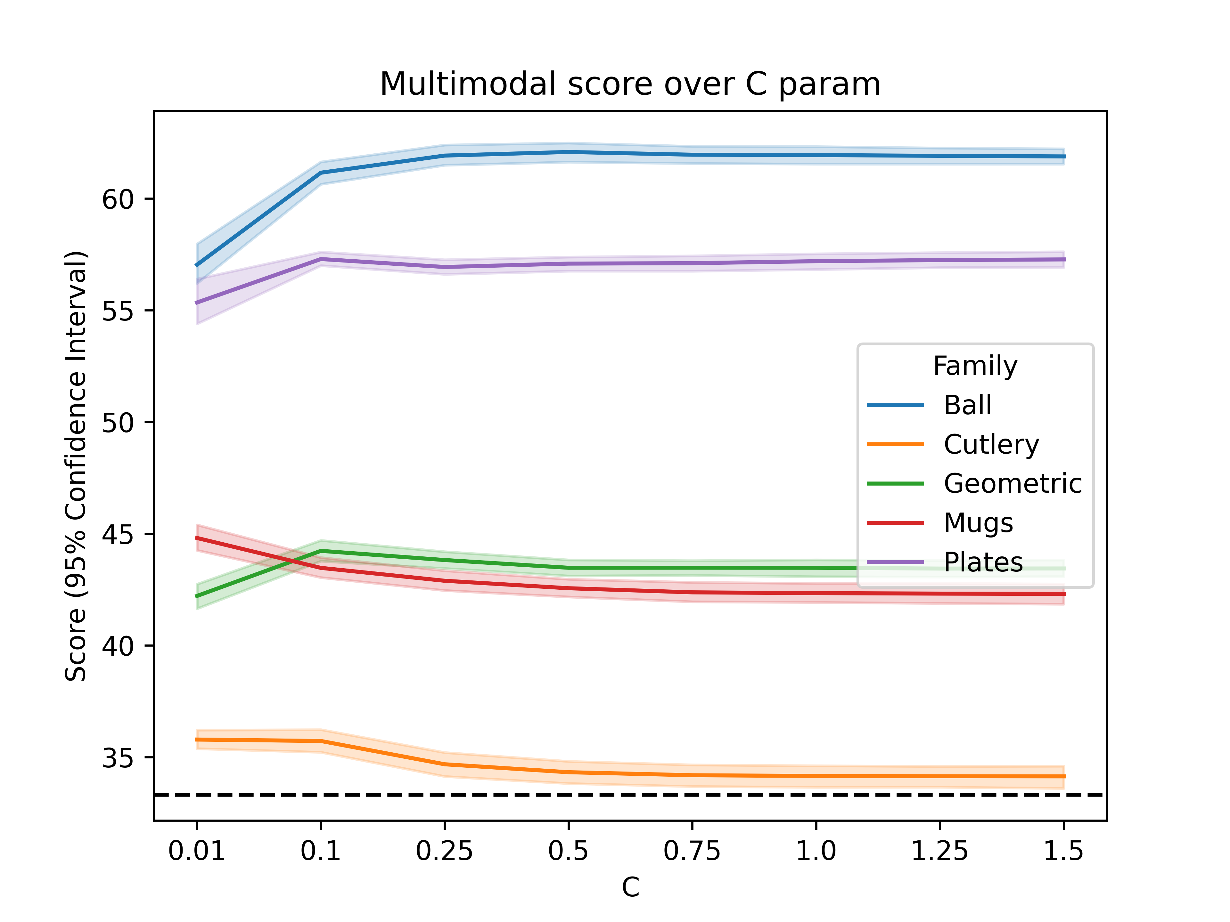
Multimodal (Kin + EMG)

Slide 23
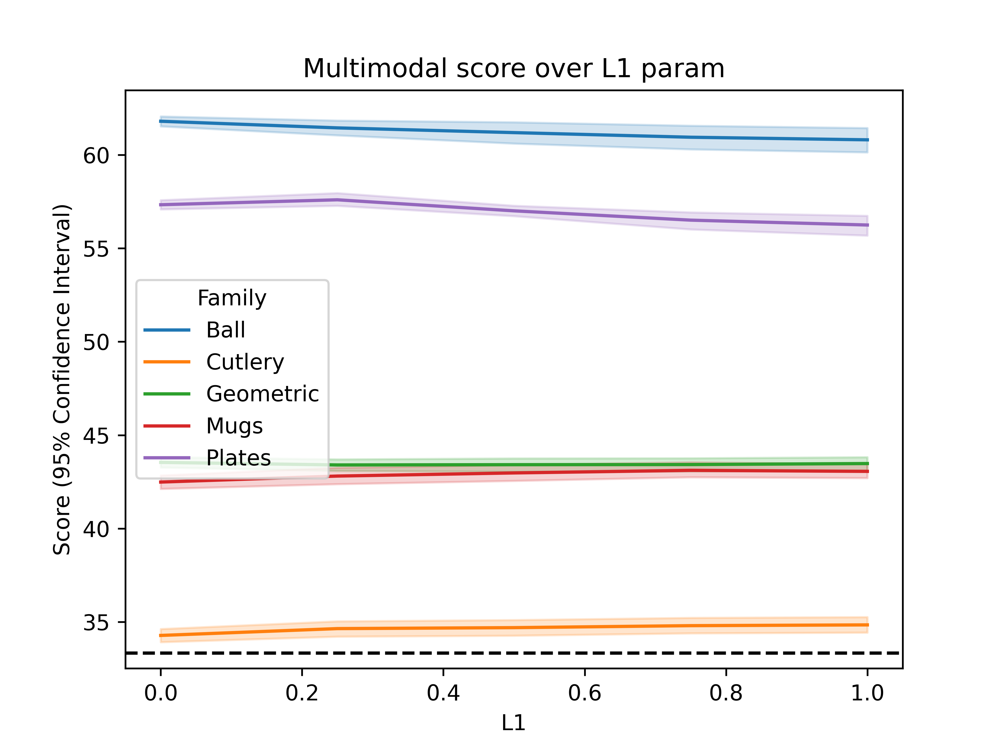
Multimodal (Kin + EMG)

Slide 24
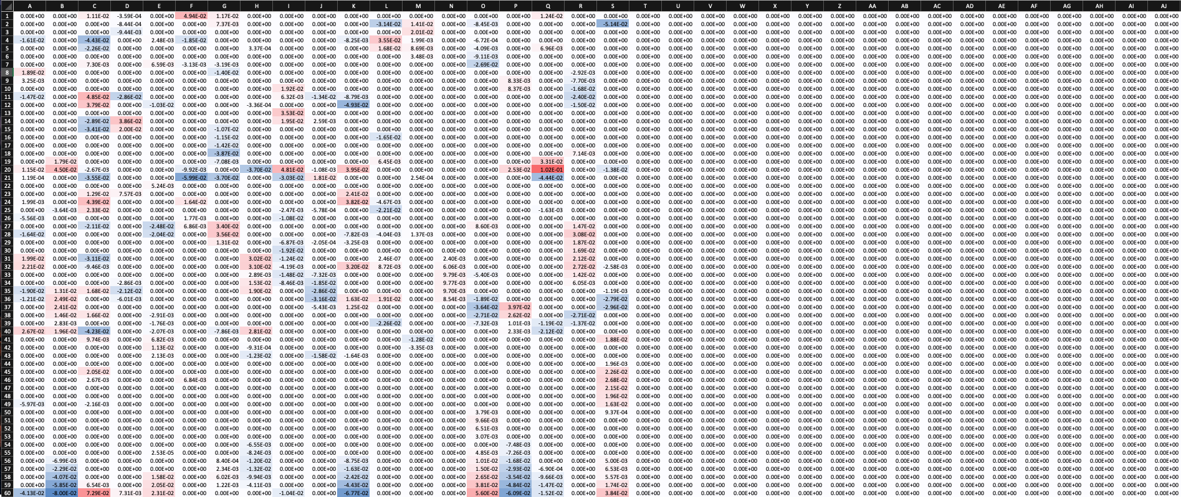
Multimodal (Kin + EMG)
This results for multisource classification are the same as those obtained by using just Kinematics.
This is because this multimodal classifier discards the EMG variables.

Slide 25
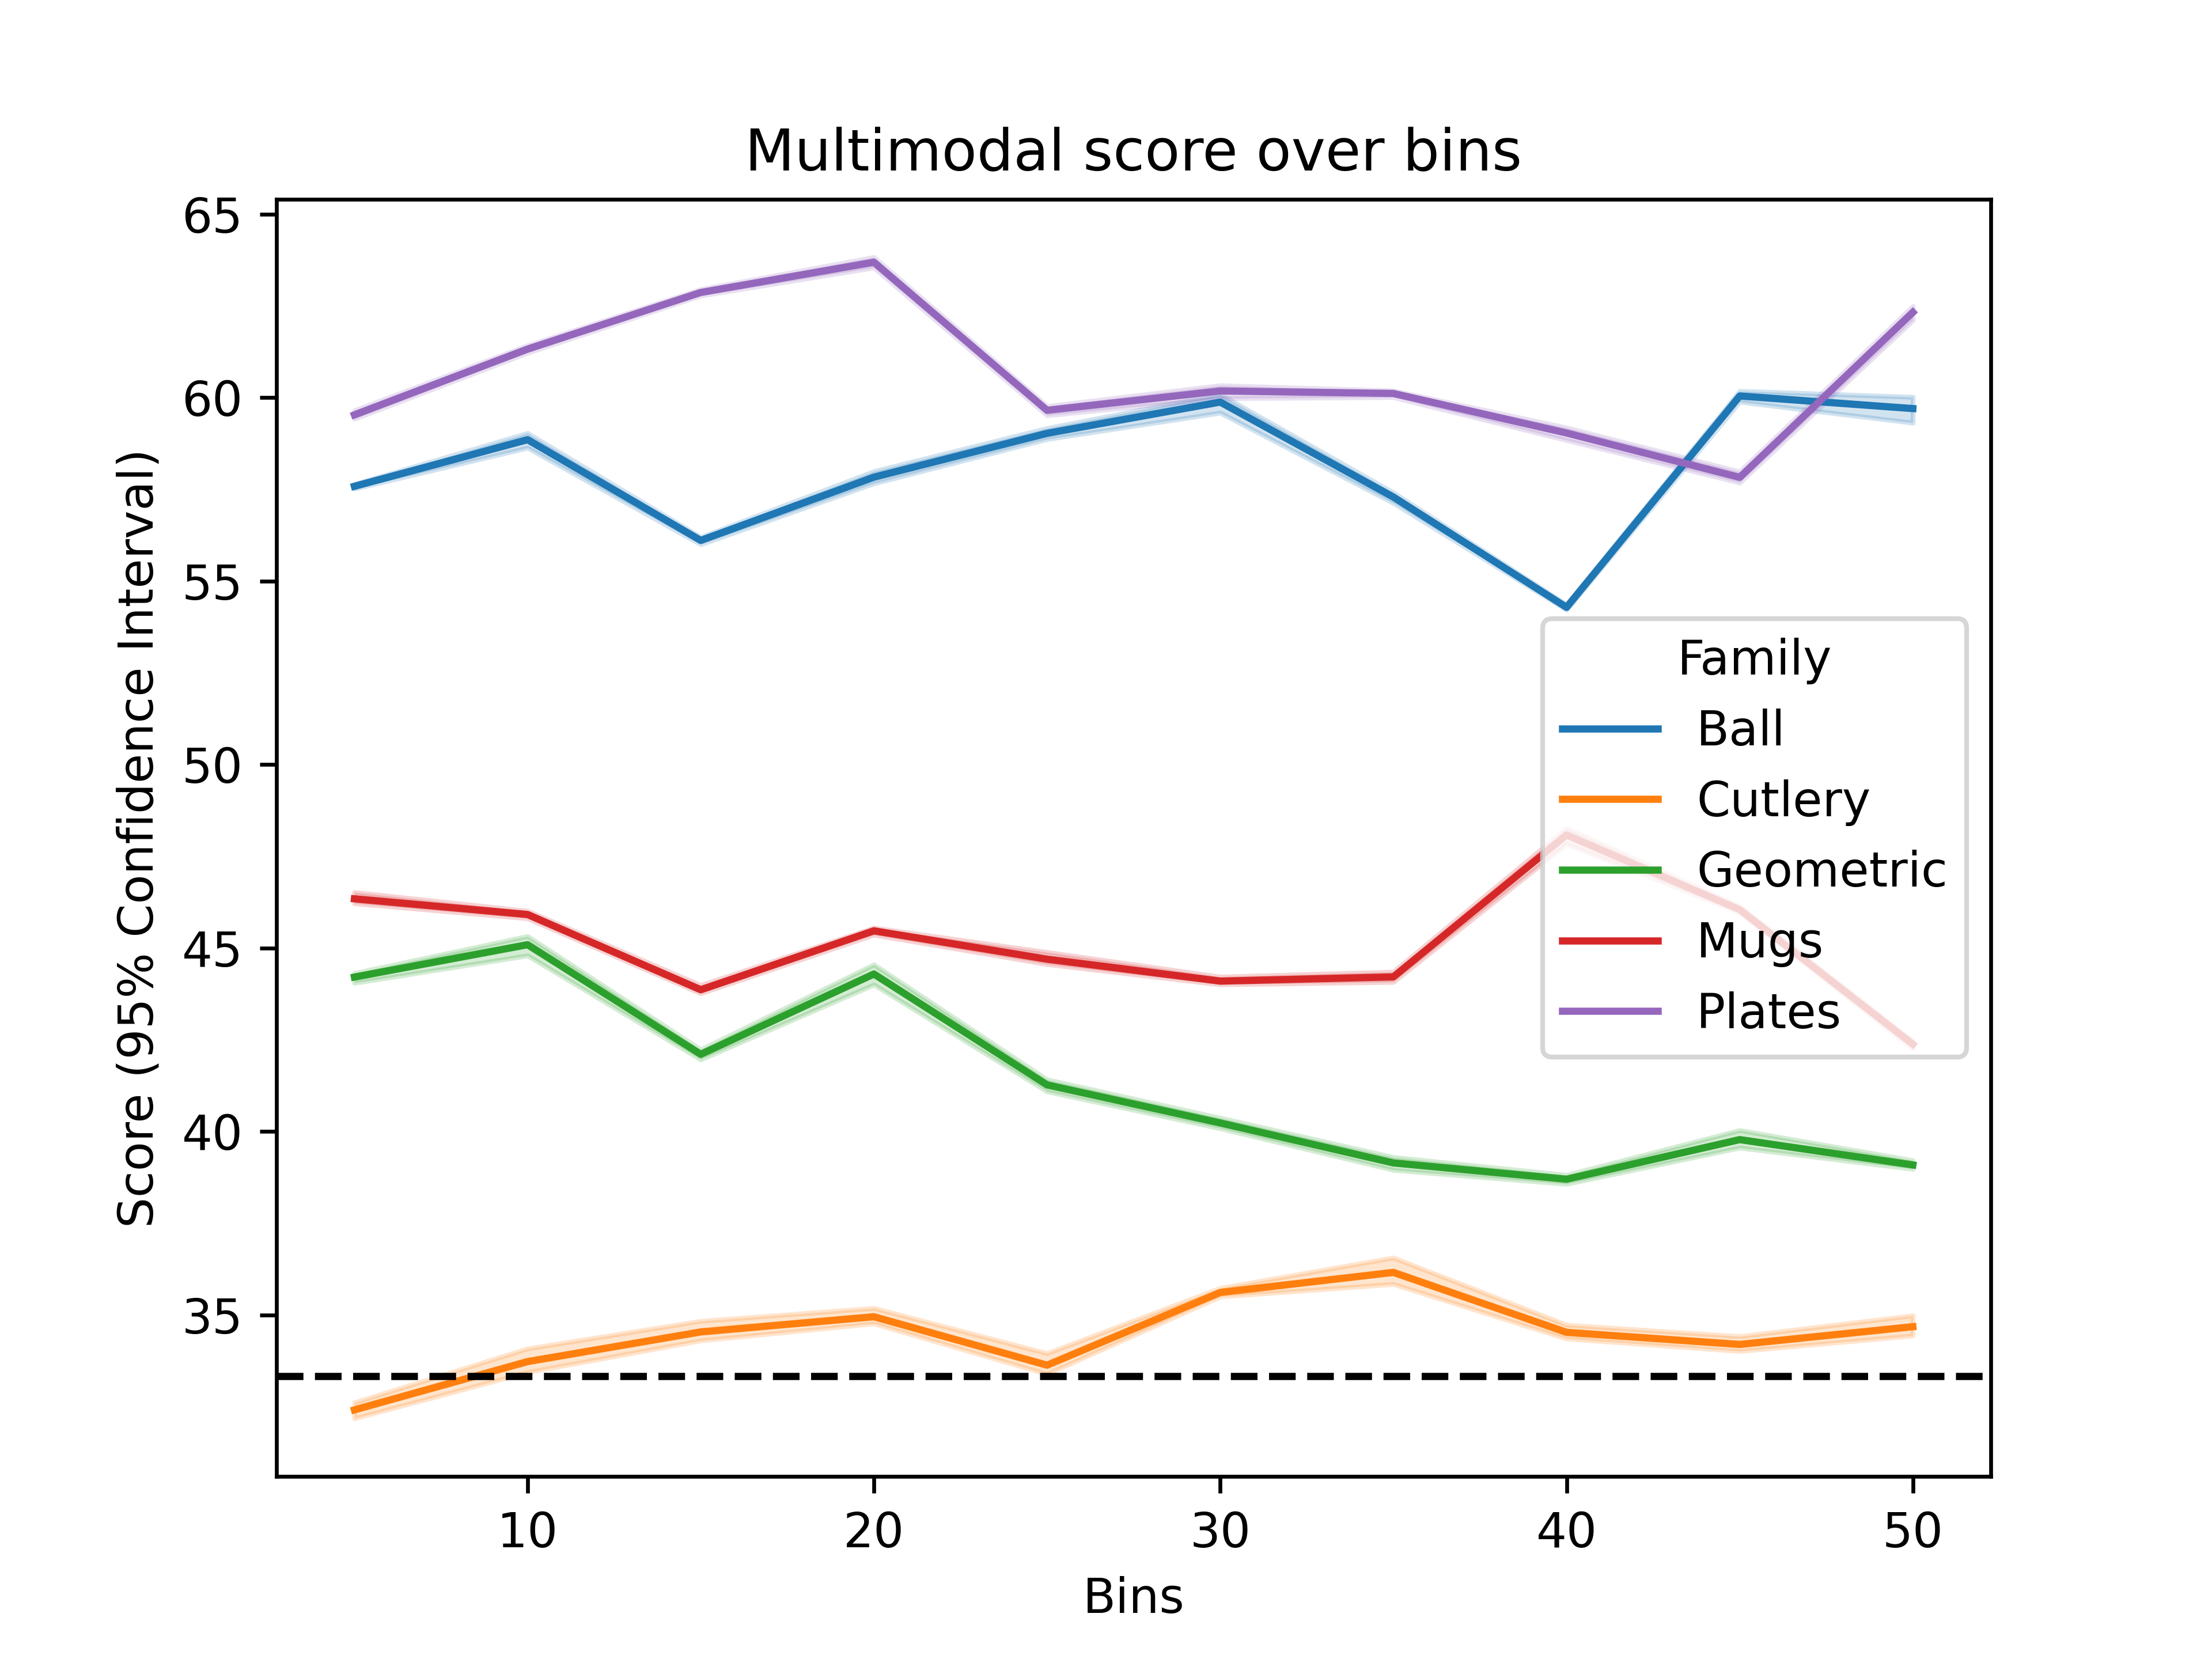
Multimodal (Kin + EMG + Tactile)

Slide 26
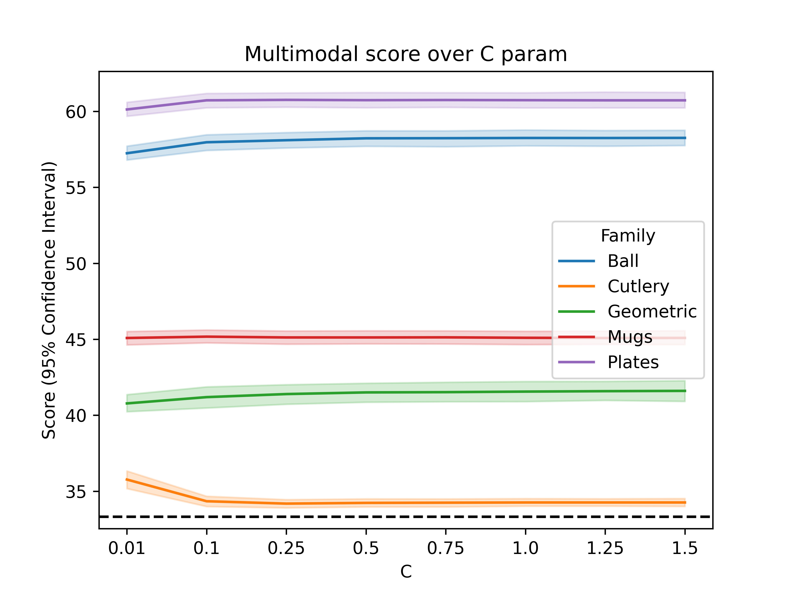
Multimodal (Kin + EMG + Tactile)

Slide 27
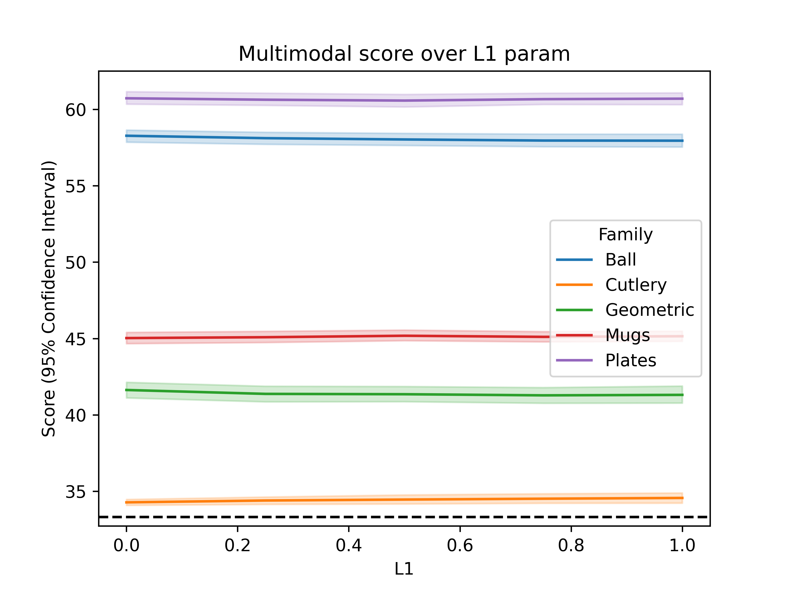
Multimodal (Kin + EMG + Tactile)

Slide 28
Multimodal (Kin + EMG + Tactile)
Adding tactile data decreases the accuracy even below that achieved with kinematic data alone

Slide 29
Hierarchical
Output = [p_{a}, p_{b}, p_{c}]
2nd Layer Model
Input = [p_{a_kin}, p_{b_kin}, p_{c_kin}, p_{a_emg}, p_{b_emg}, p_{c_emg}]
Output = [p_{a}, p_{b}, p_{c}]
Output = [p_{a}, p_{b}, p_{c}]
Kinematic Model
EMG Model

Slide 30
Hierarchical
We have tested this approach with Kin + EMG and with Kin + EMG + Tactile.
Both perform better than any previous method.
Hierarchical with Kin + EMG performs slightly better than if we add the tactile data.

Slide 31
Comparison of model accuracies

Slide 32
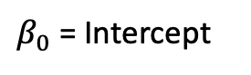

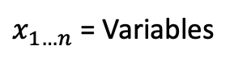
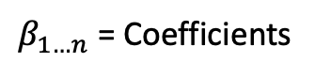
Analysis of weights
p(Class) = $\frac{1}{1+e^{−(β_{0}+β_{1}x_{1}+β_{2}x_{2}+…+β_{n}x_{n})}}$
$β_{0}$ = Intercept
$x_{1…n}$ = Variables
$β_{1…n}$ = Coefficients
The influence of a given variable “i” is given by the product $β_{i}x_{i}$

Slide 33
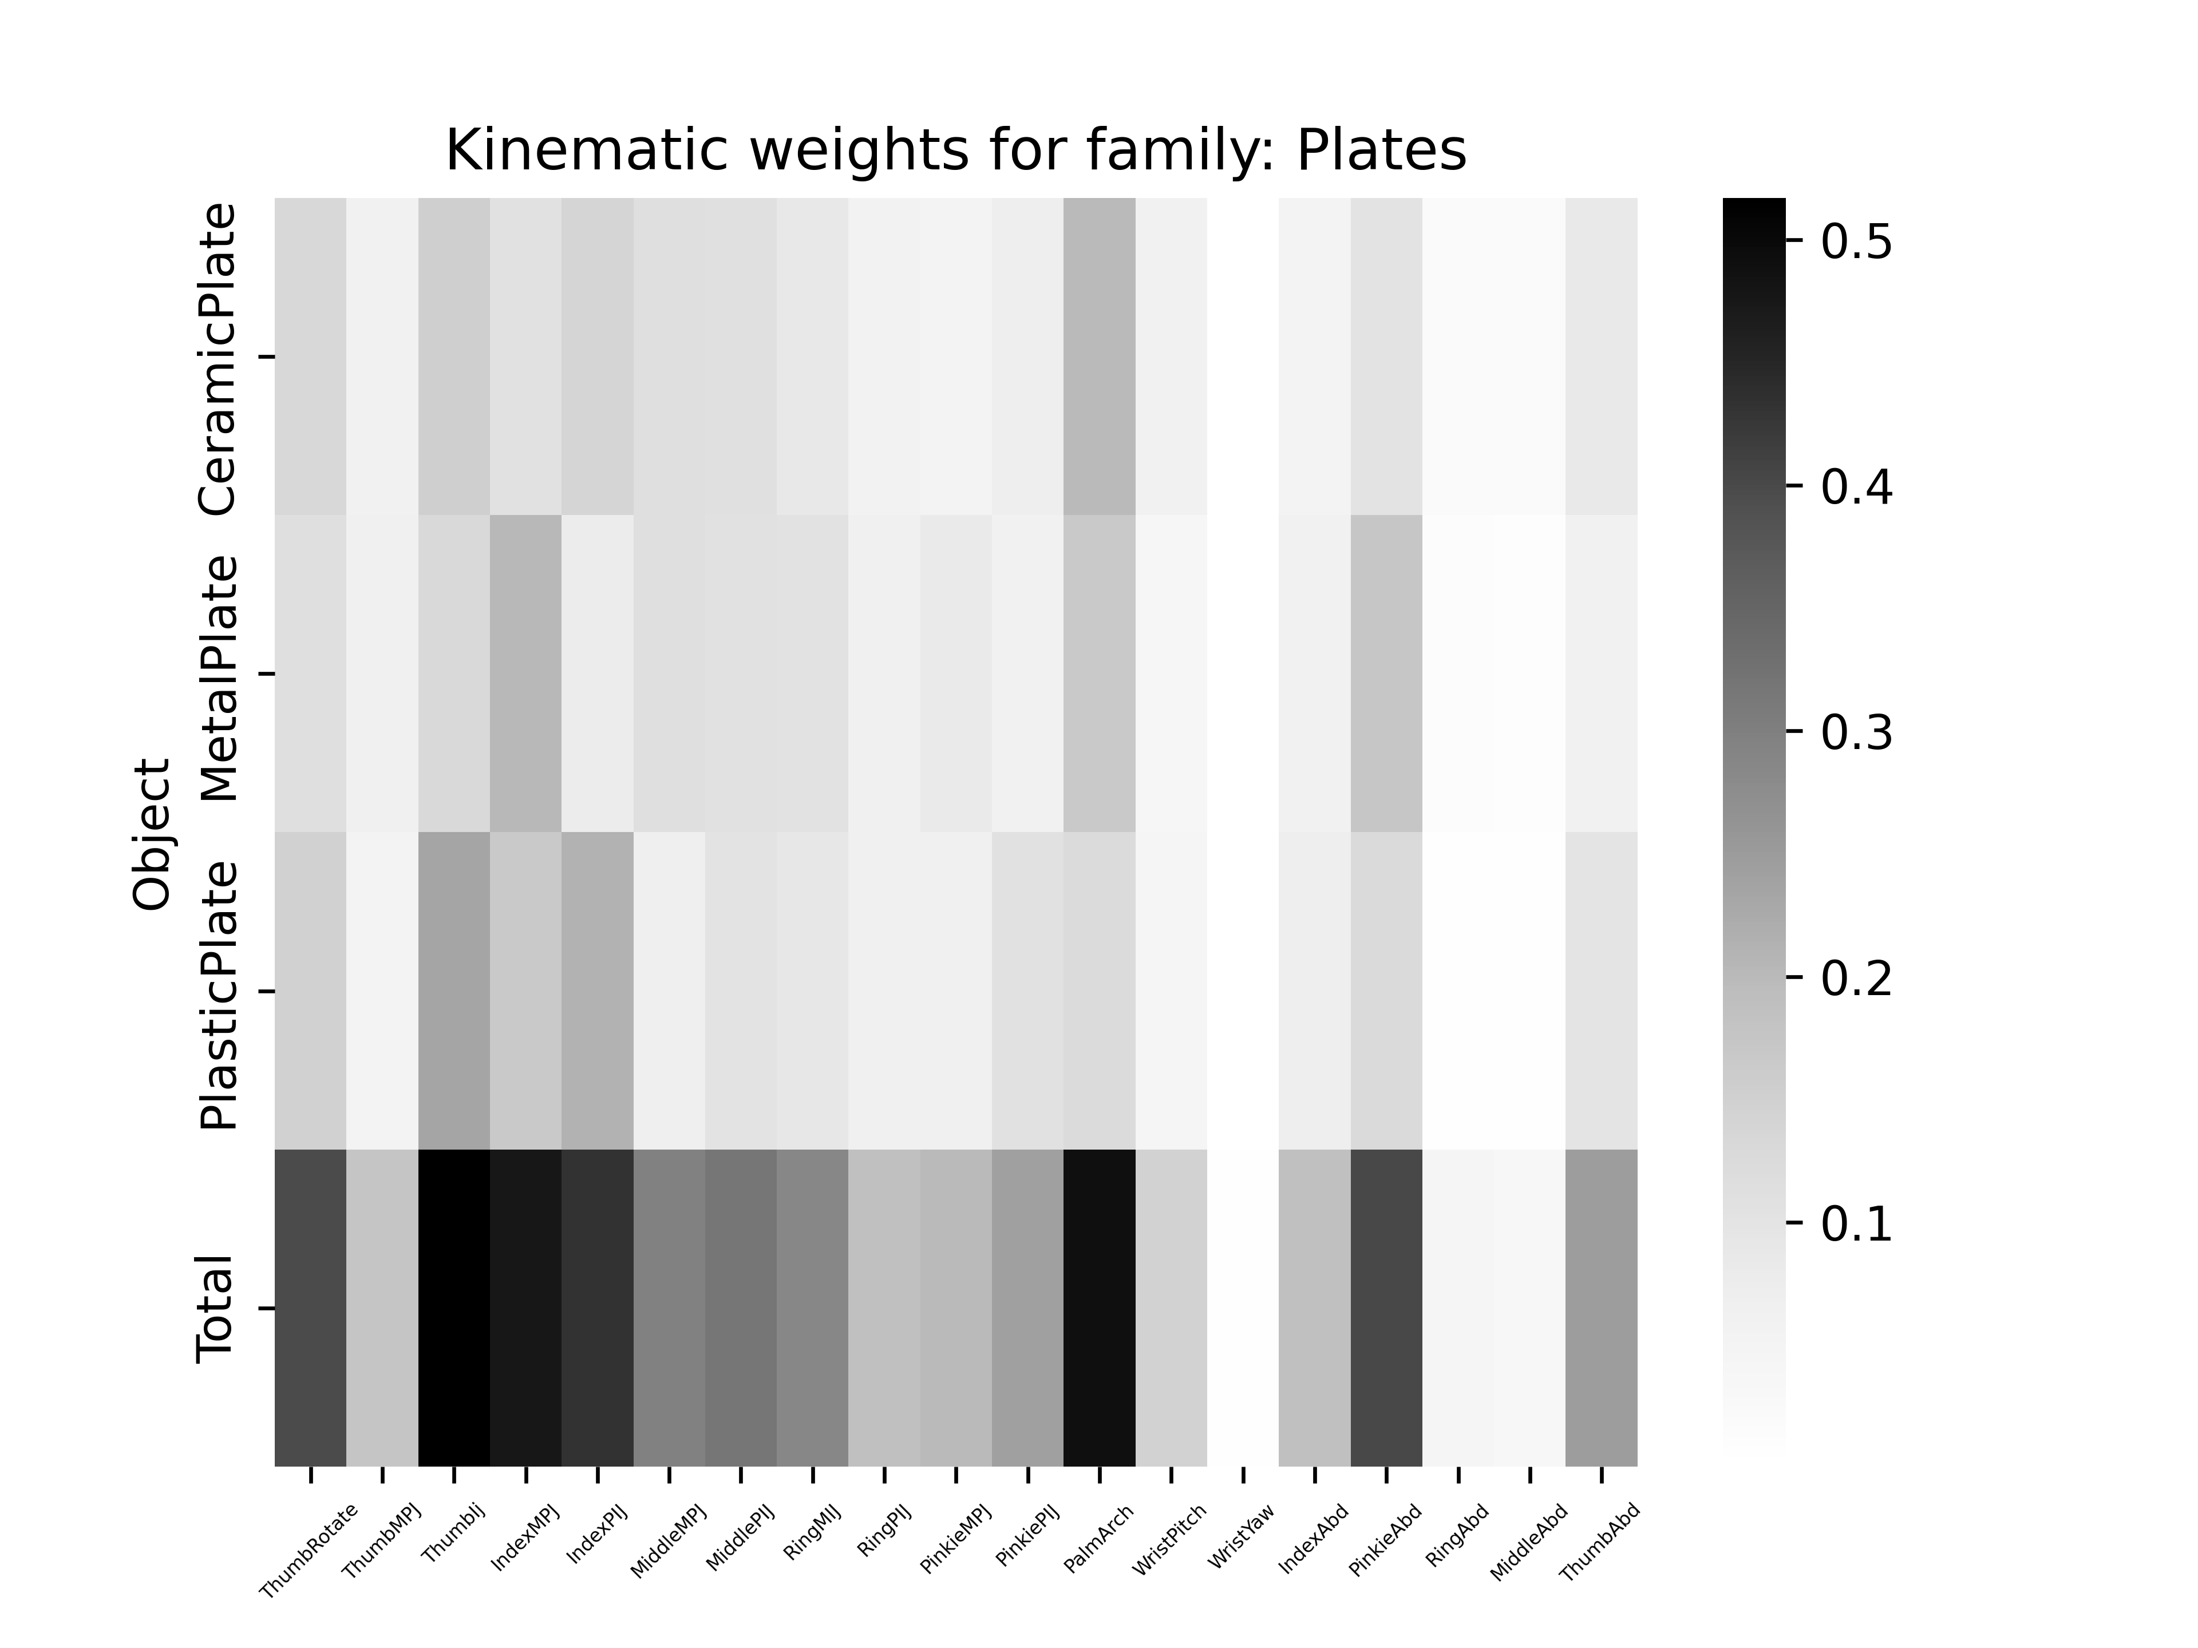
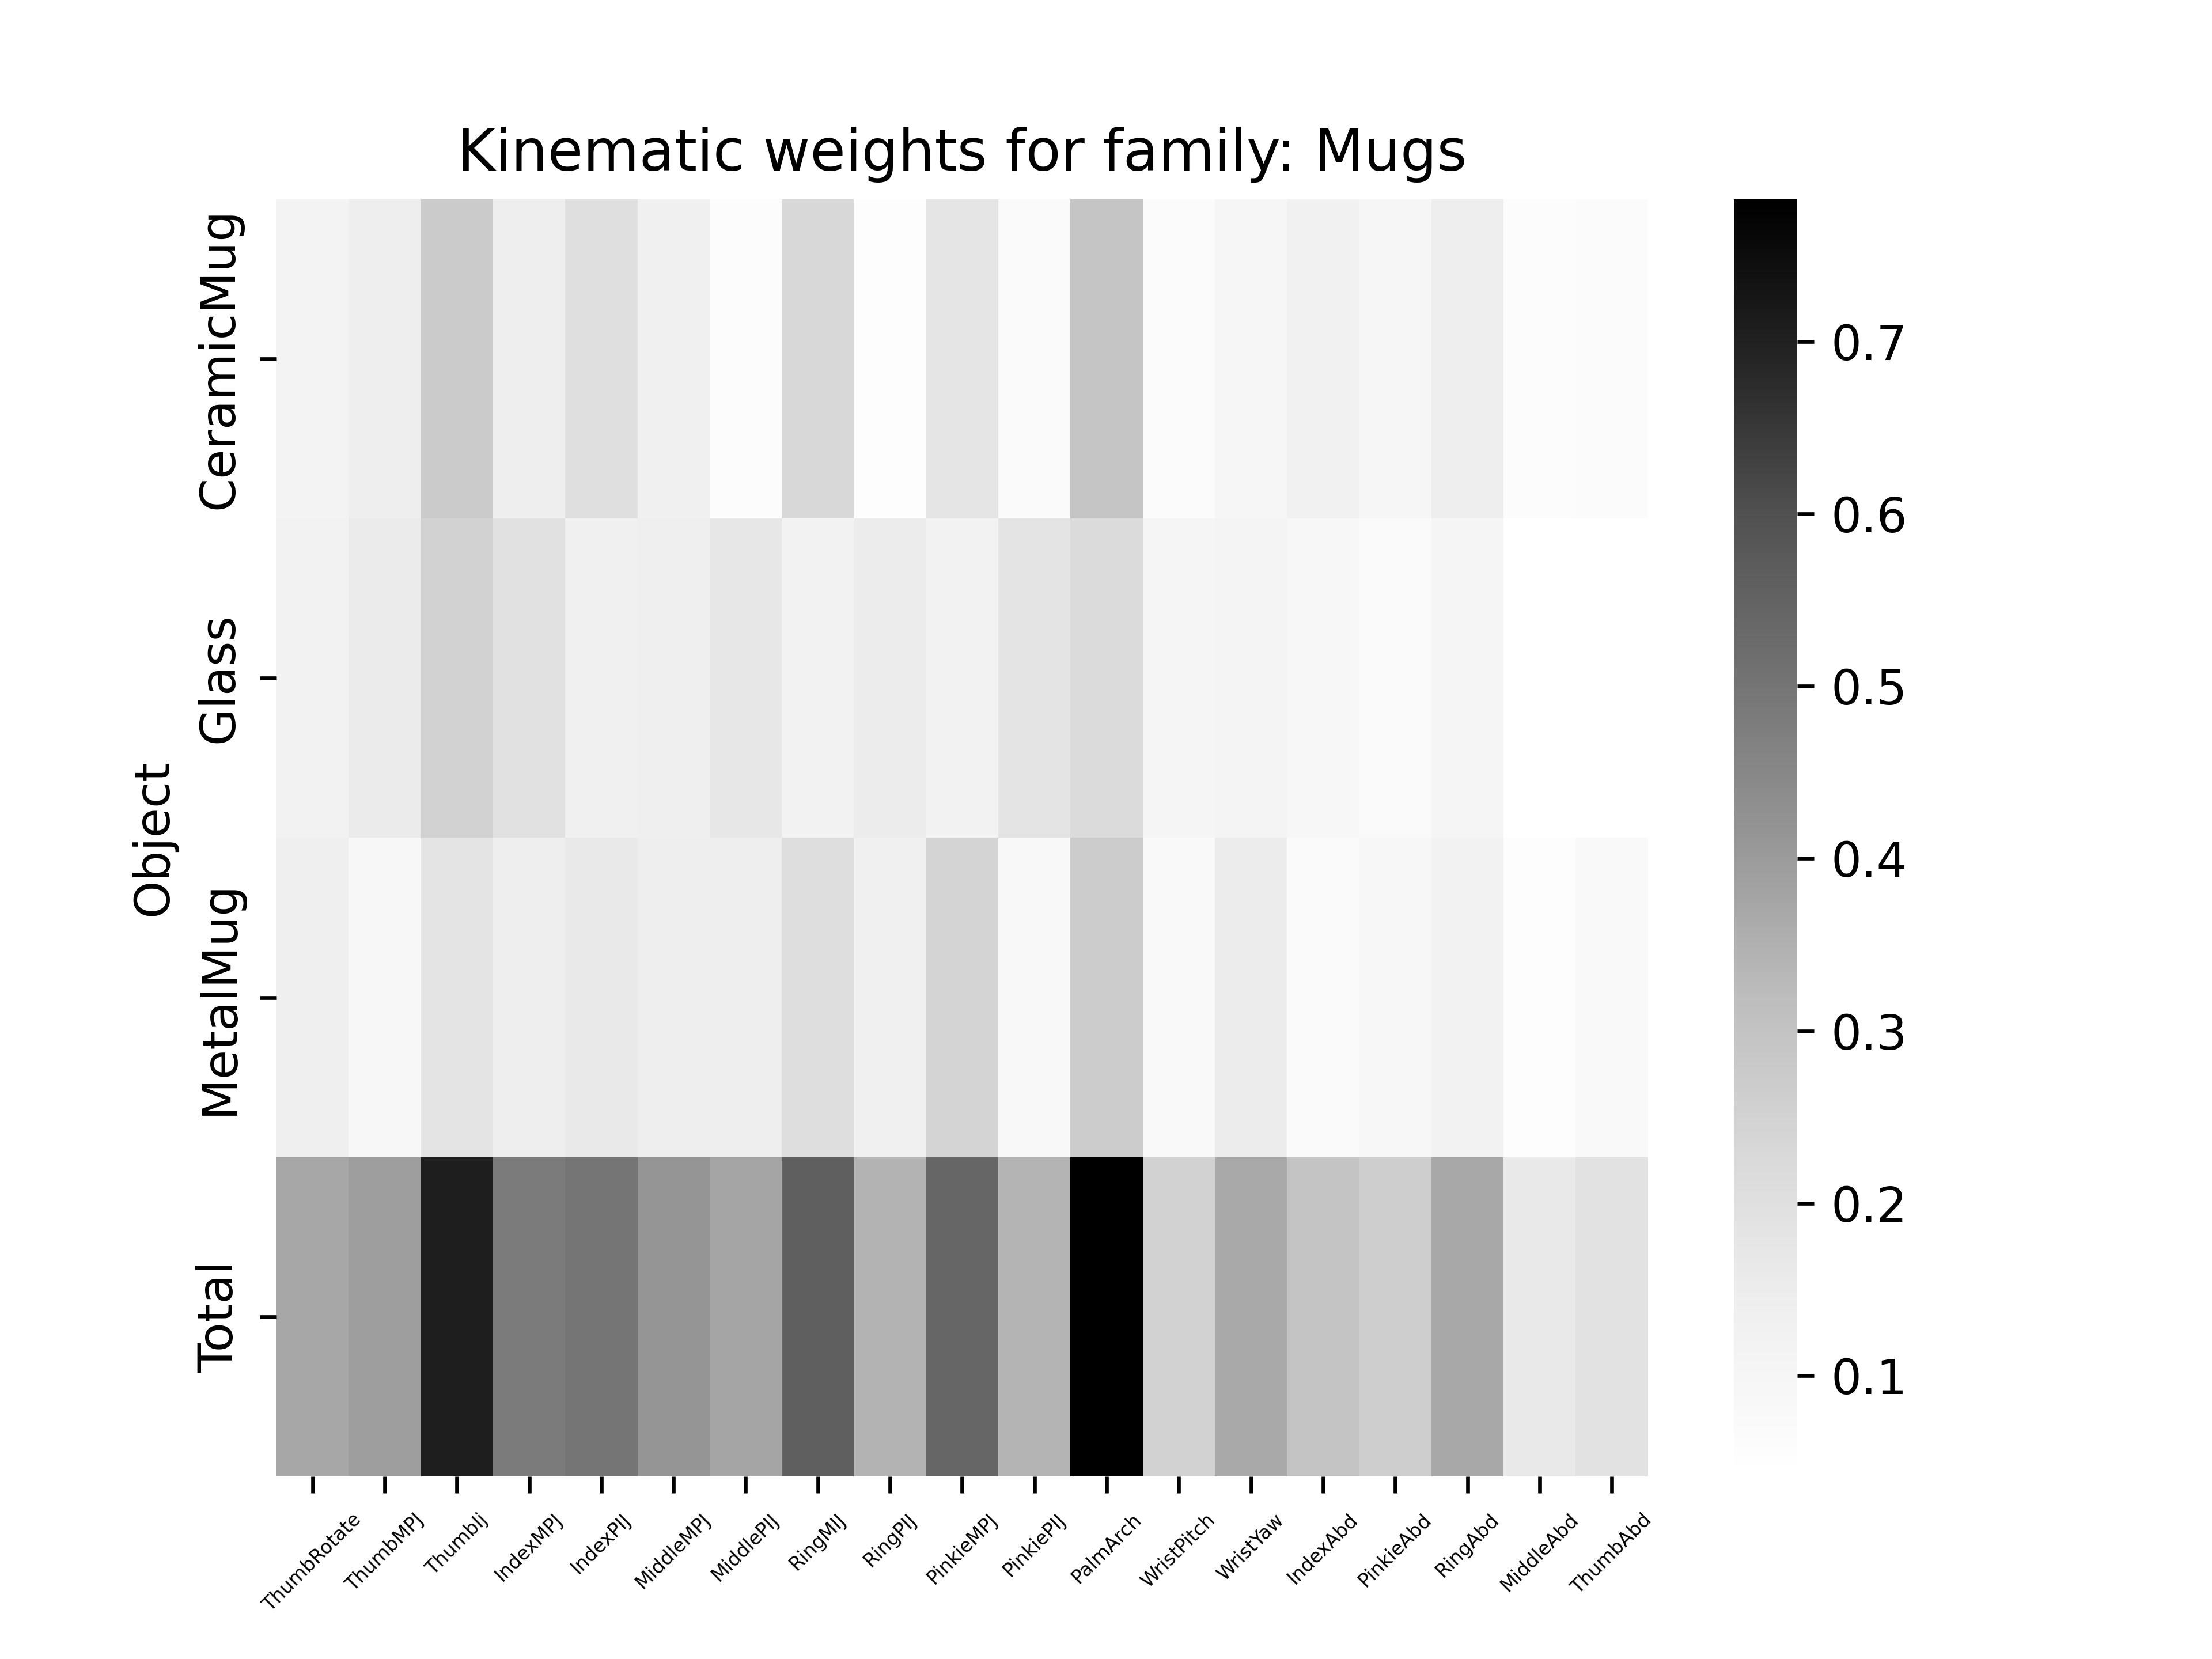
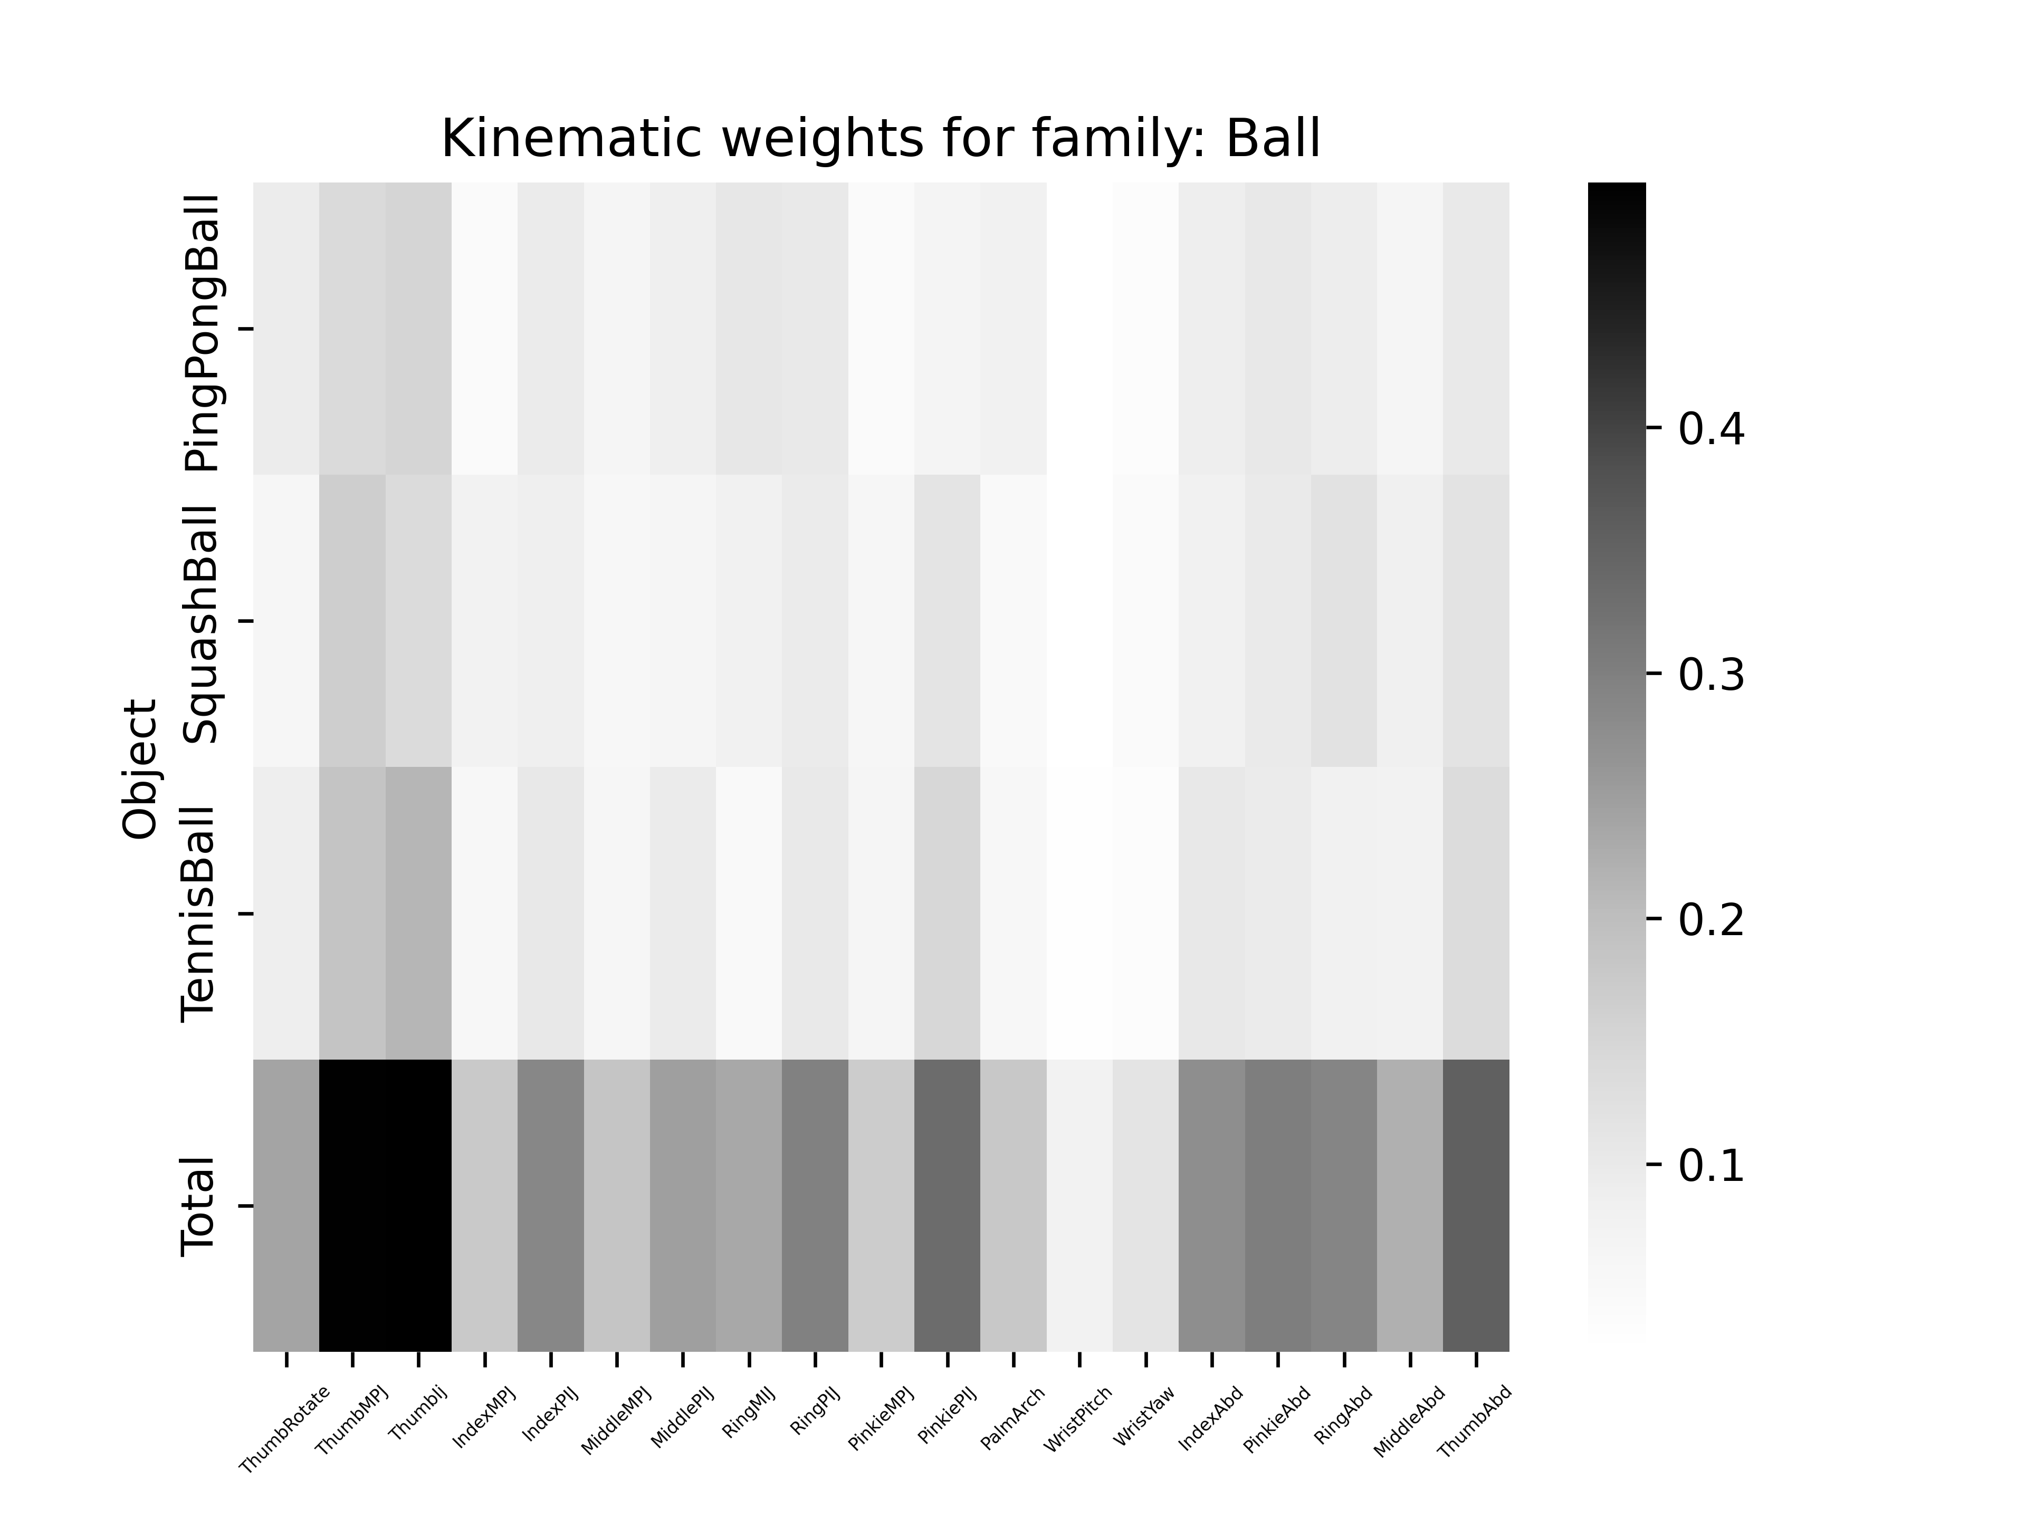
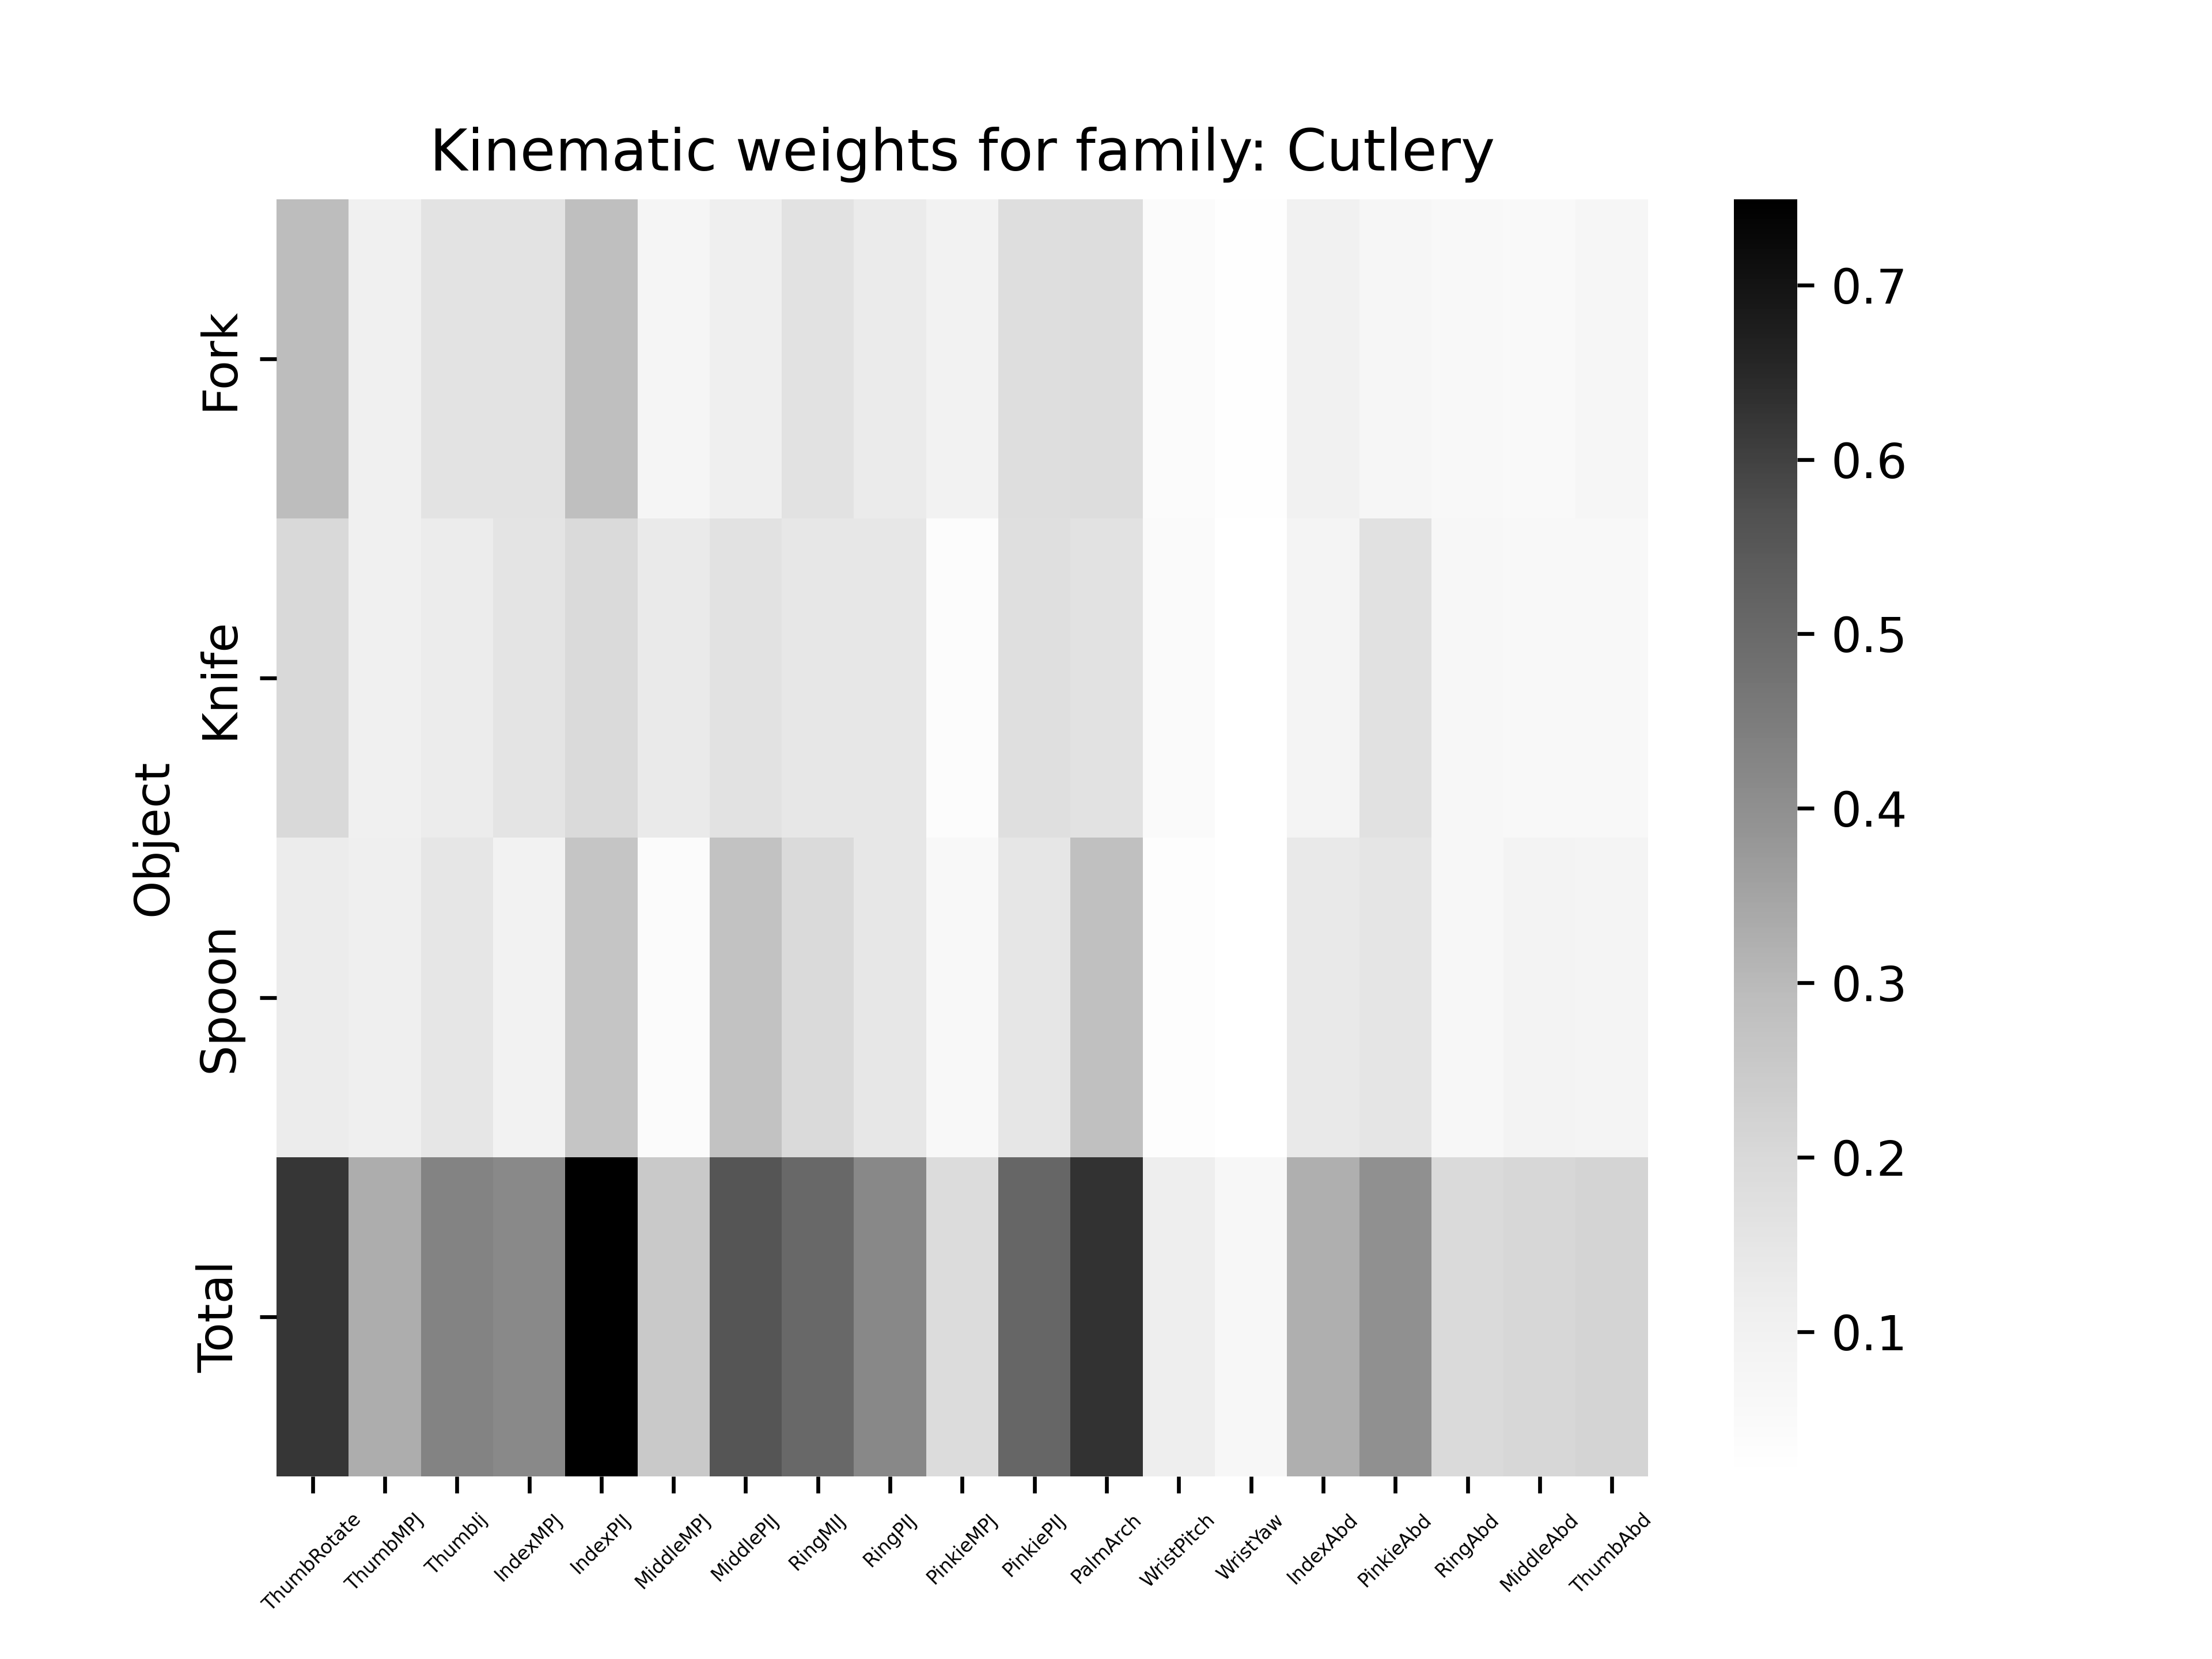
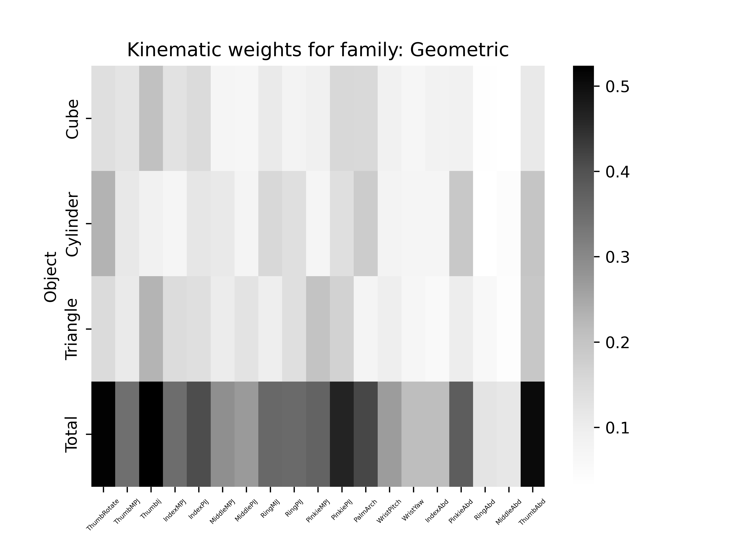
Analysis of weights

Slide 34
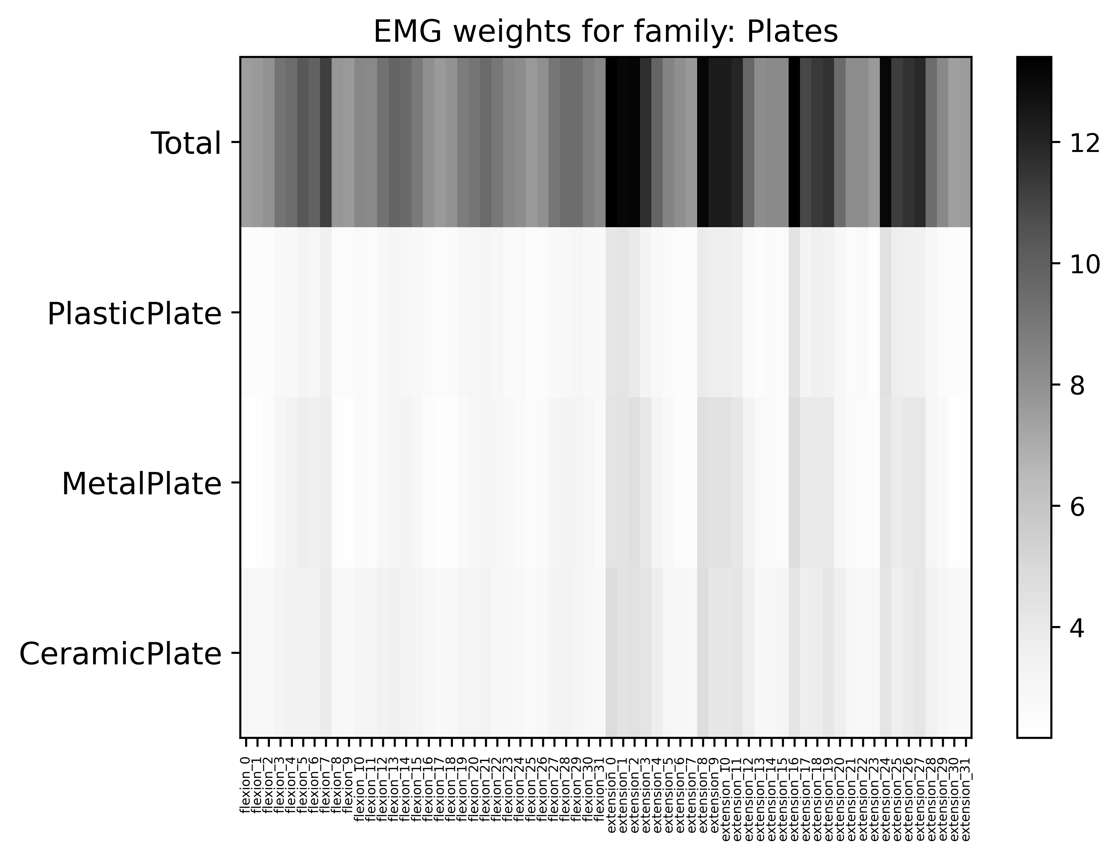
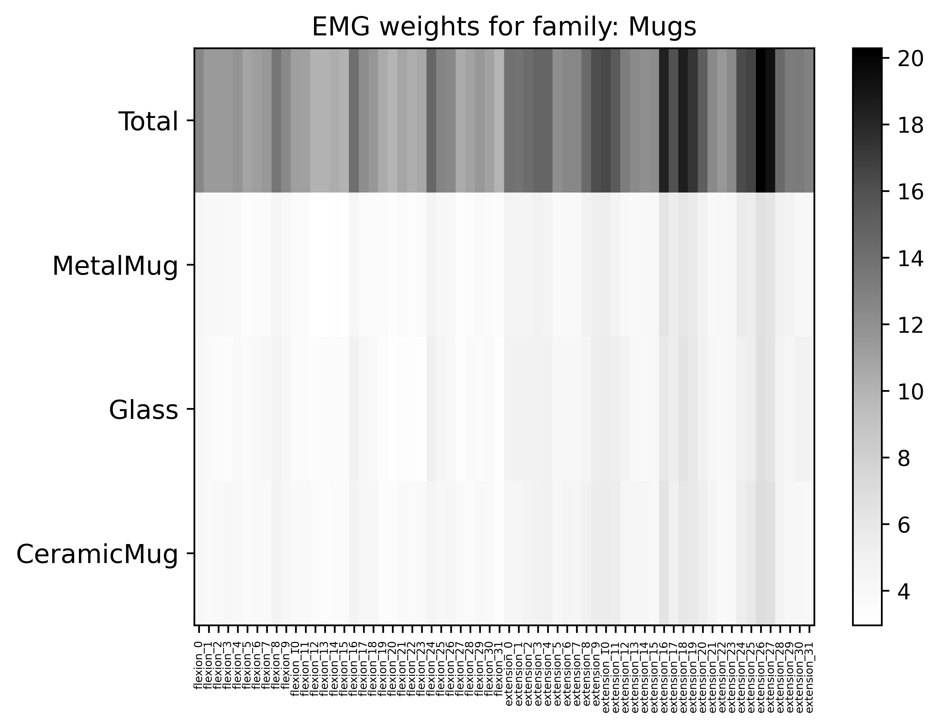
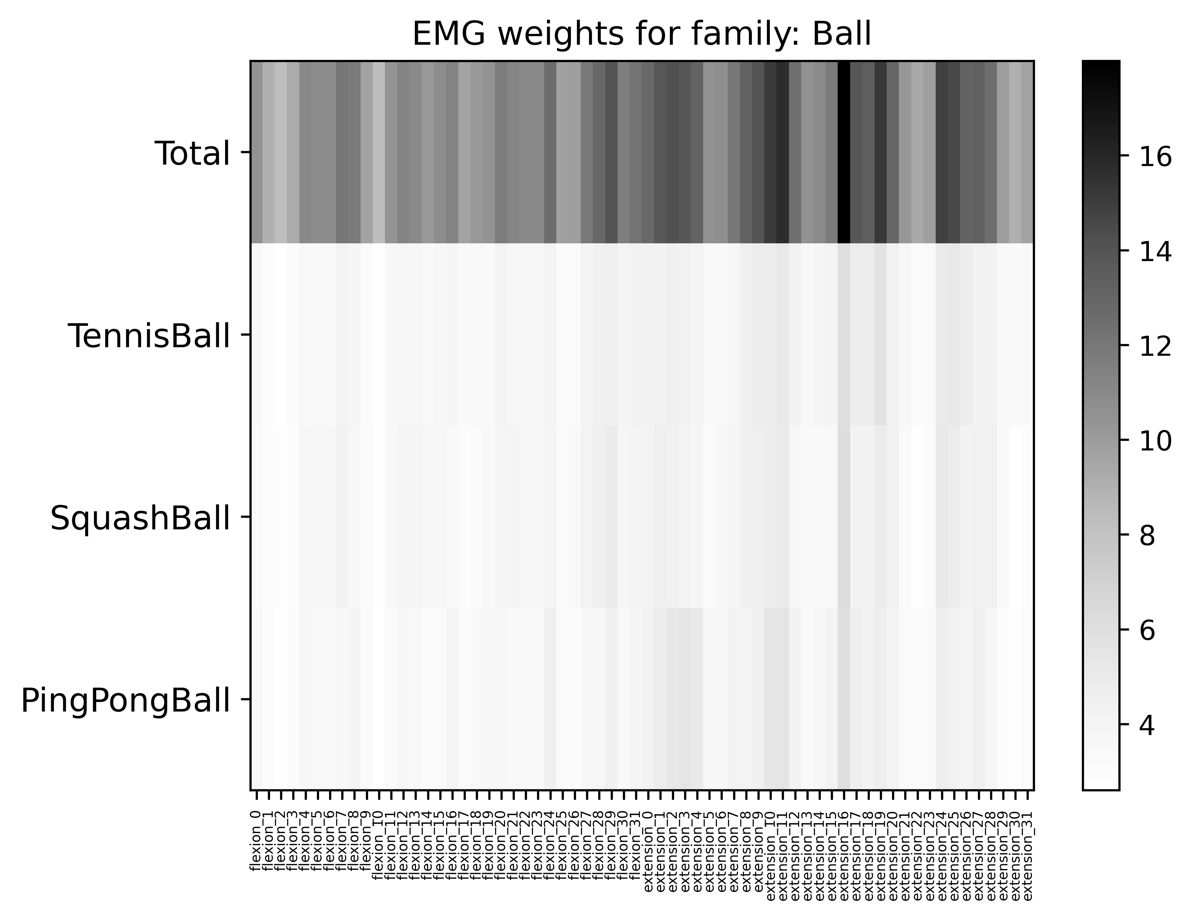
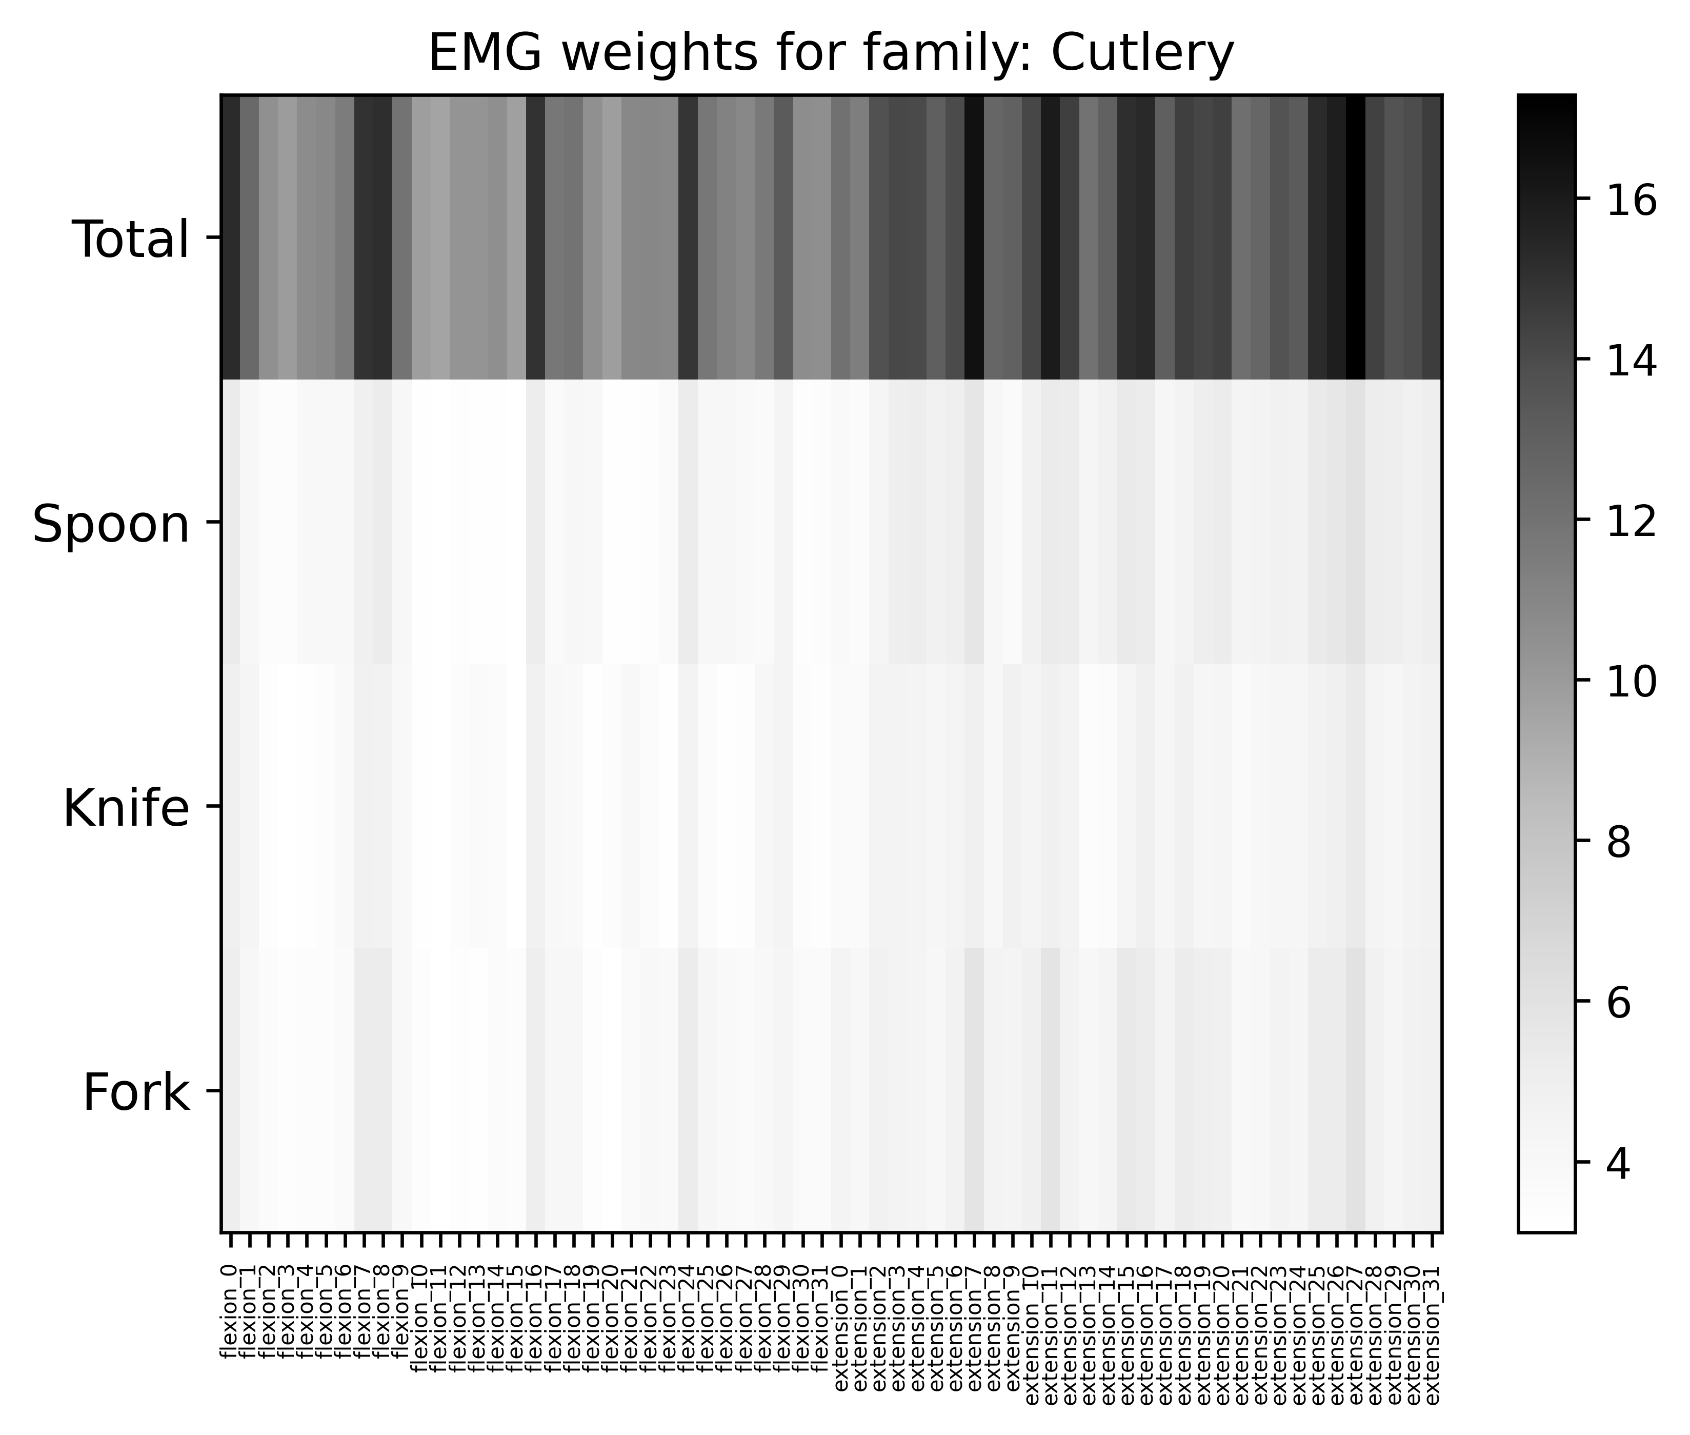
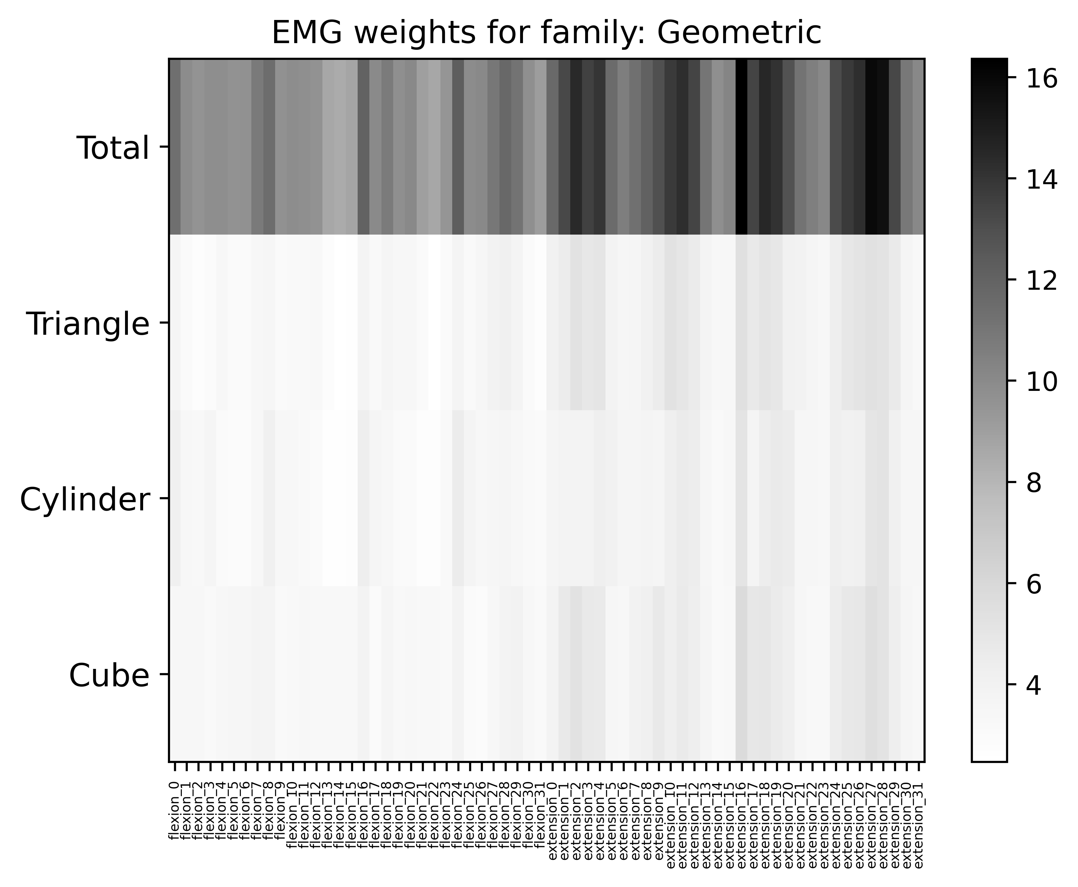
Analysis of weights

Slide 35
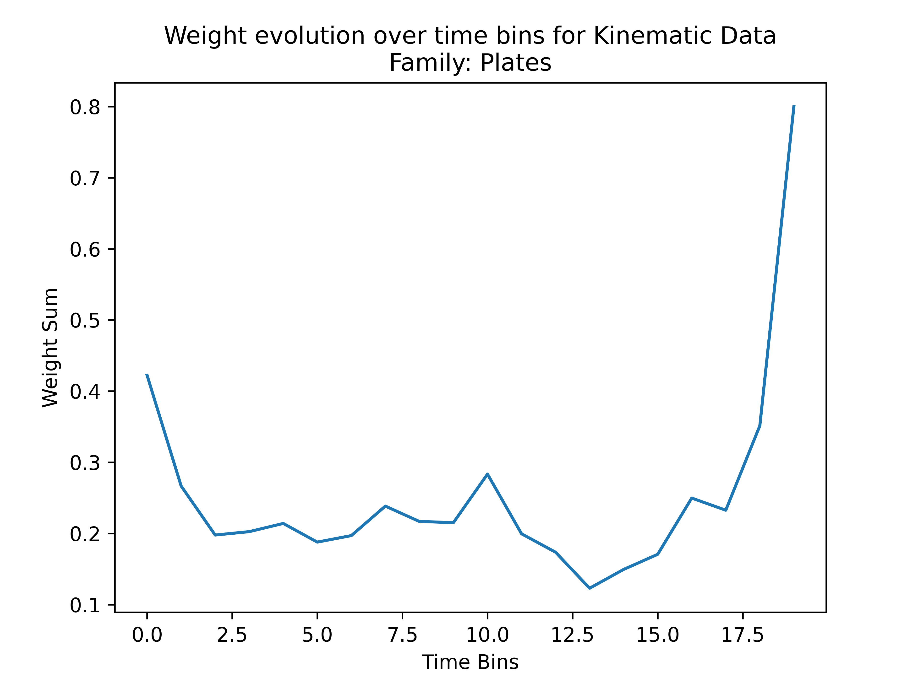
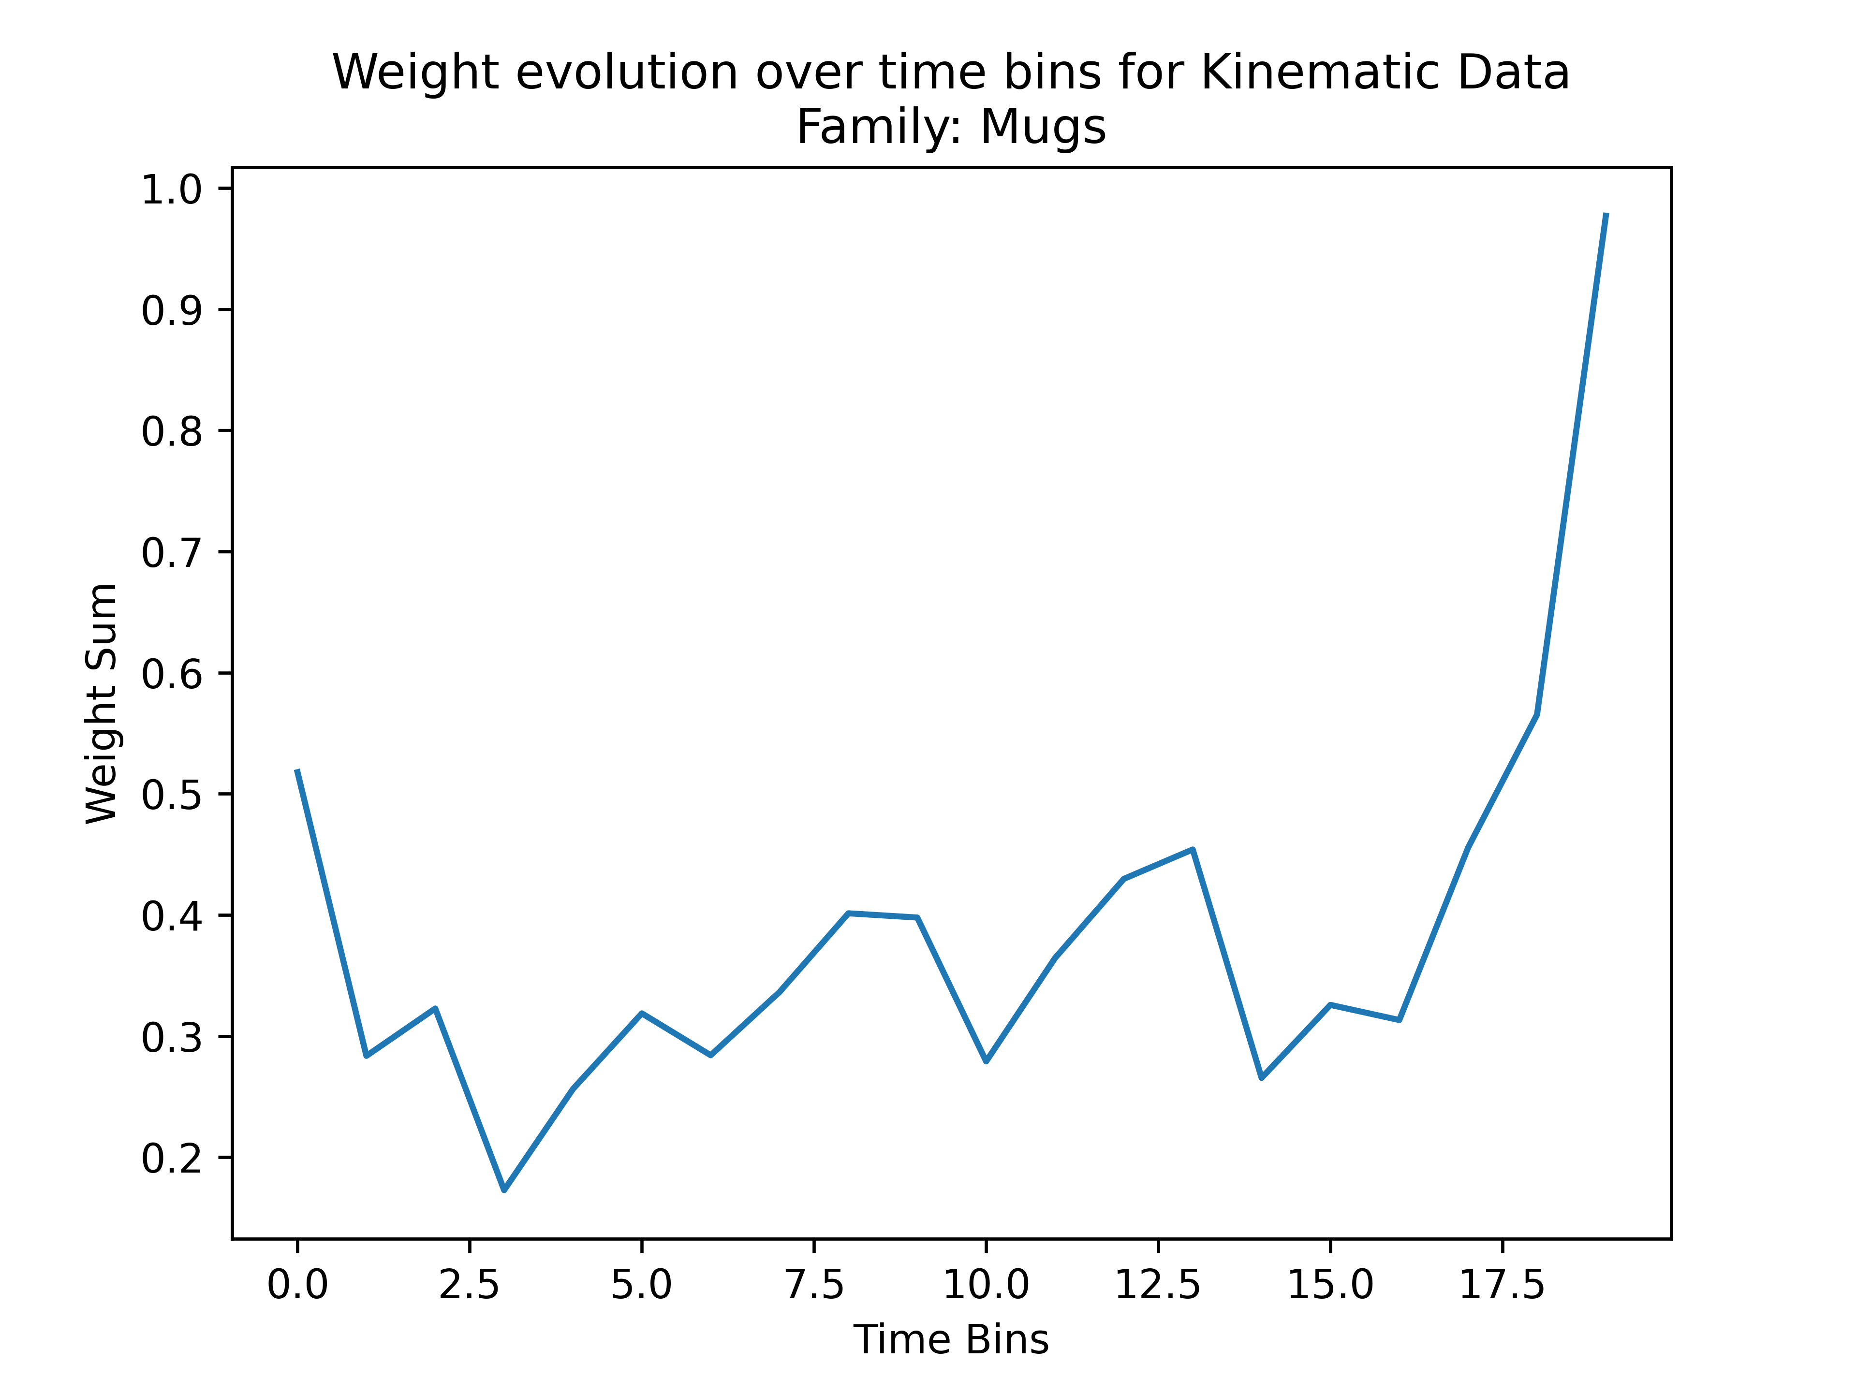
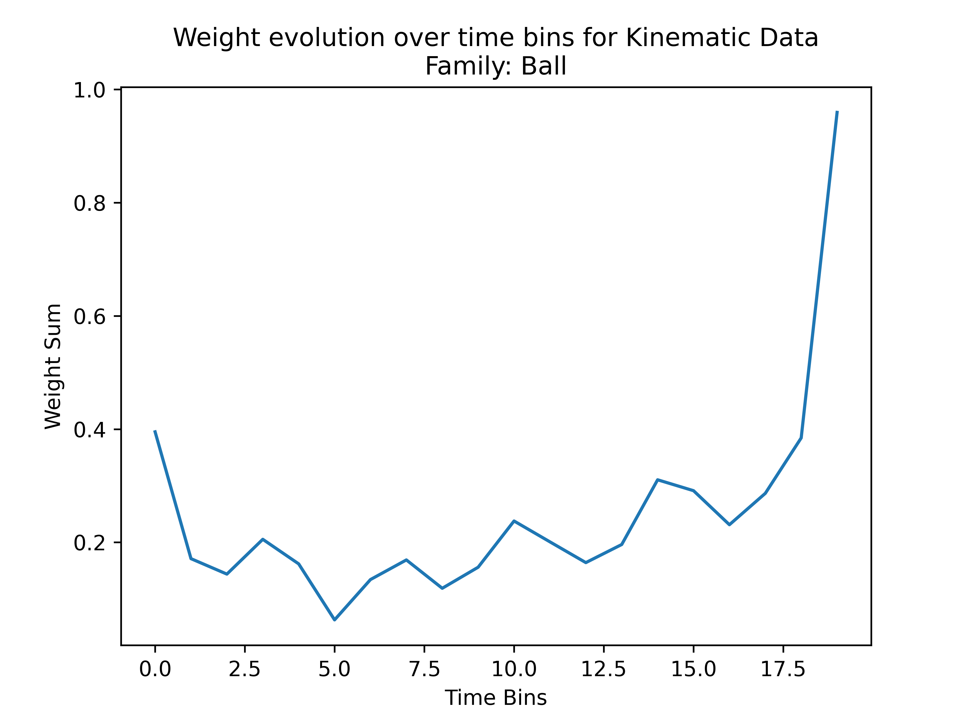
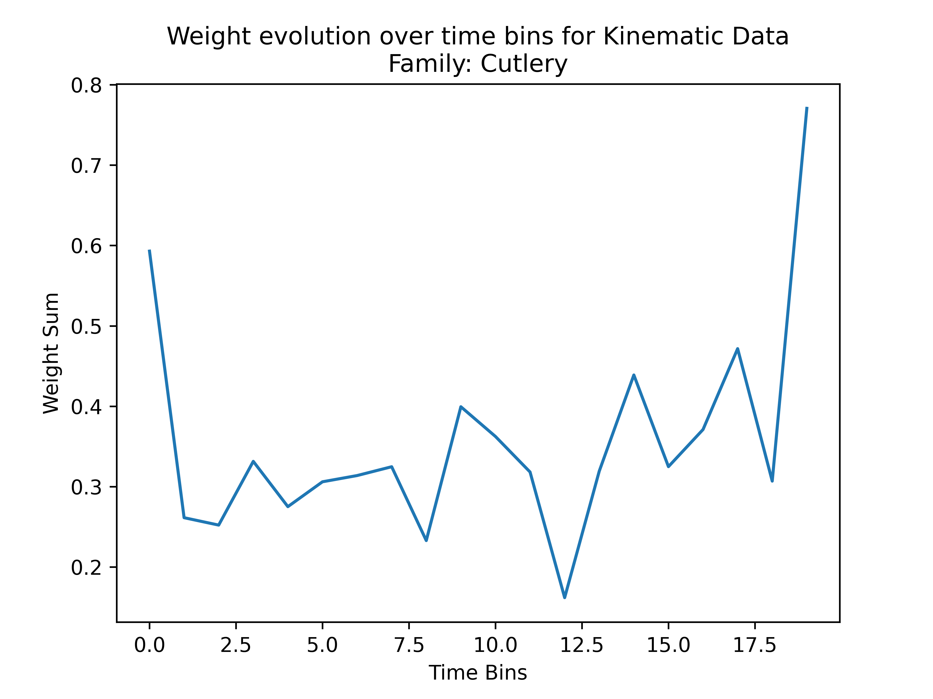
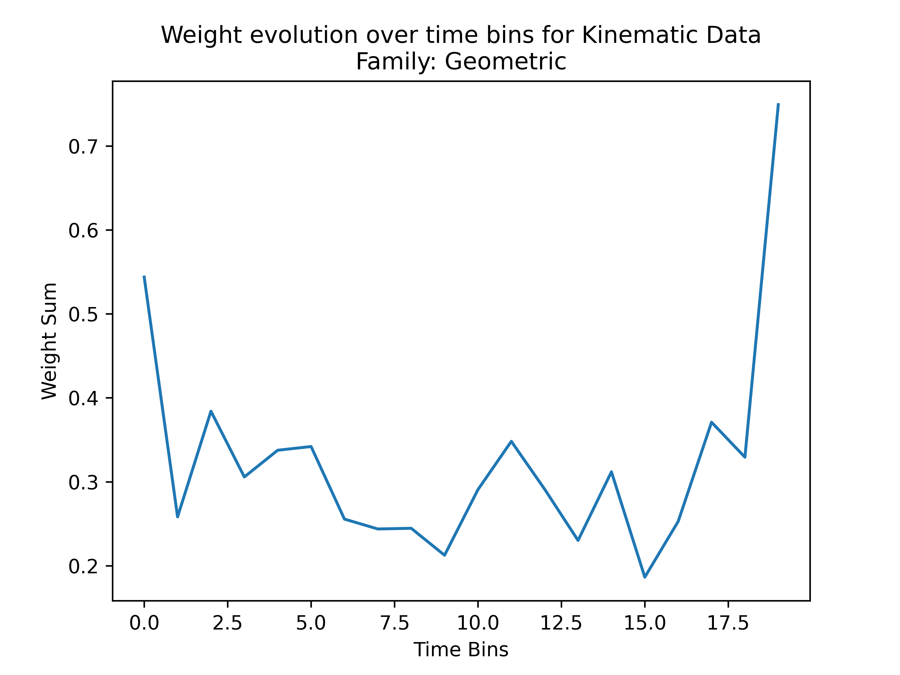
Analysis of weights

Slide 36
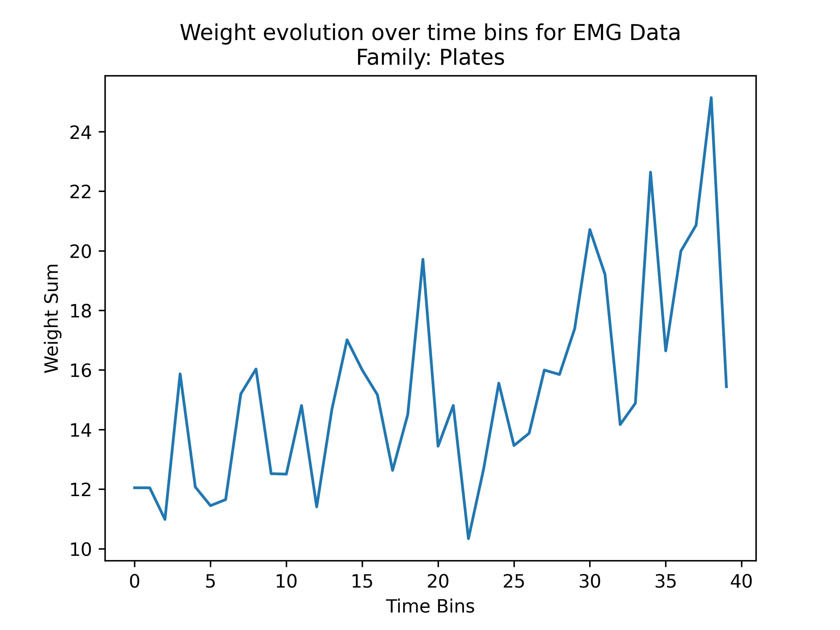
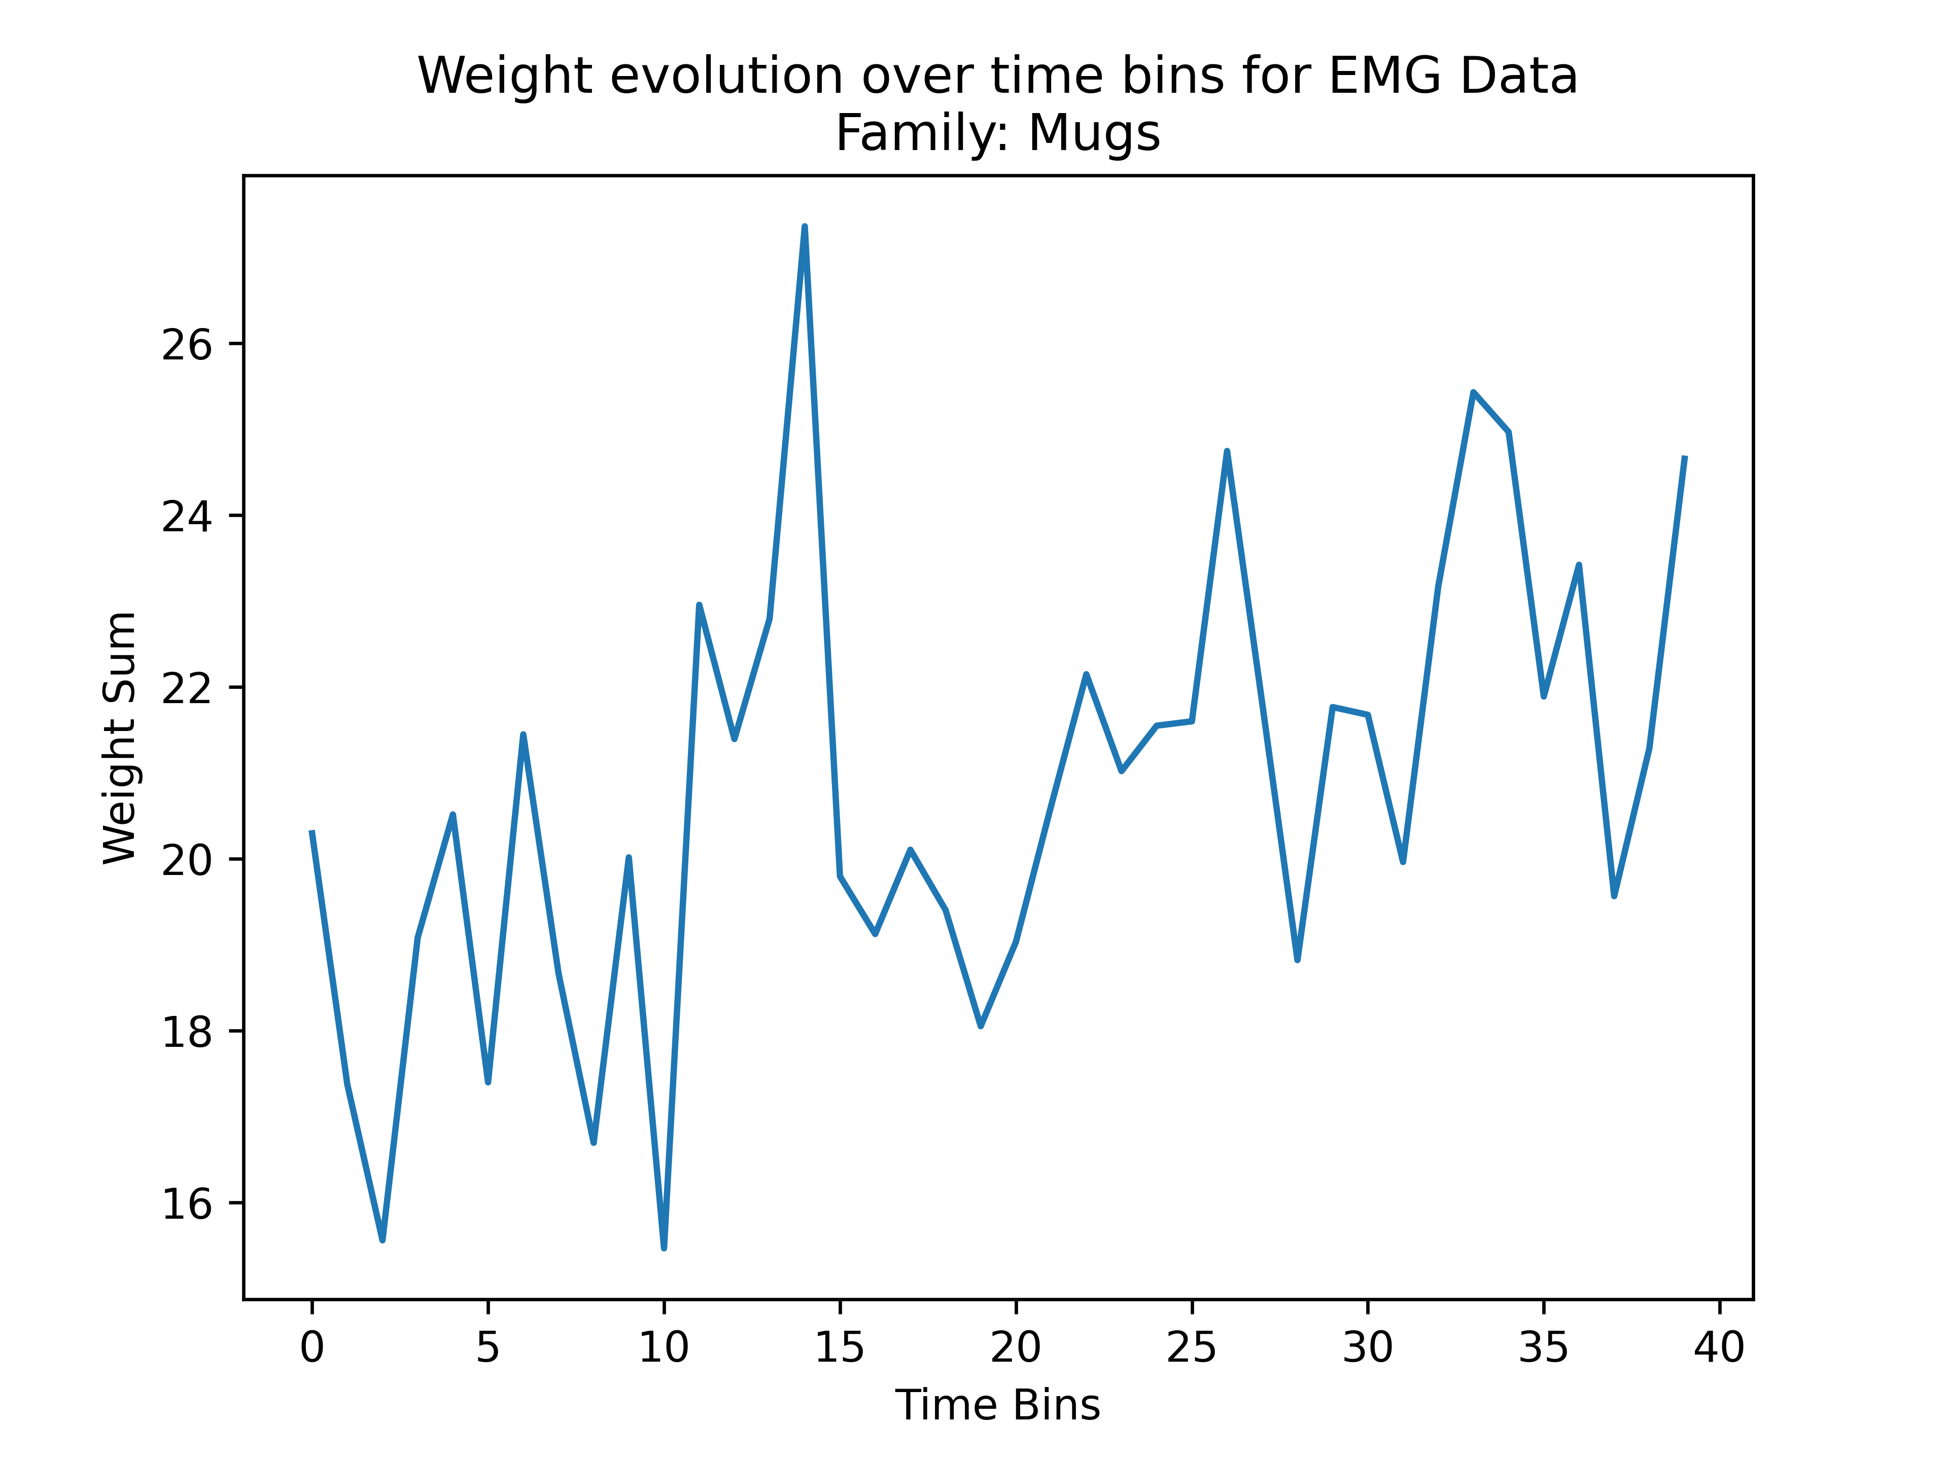
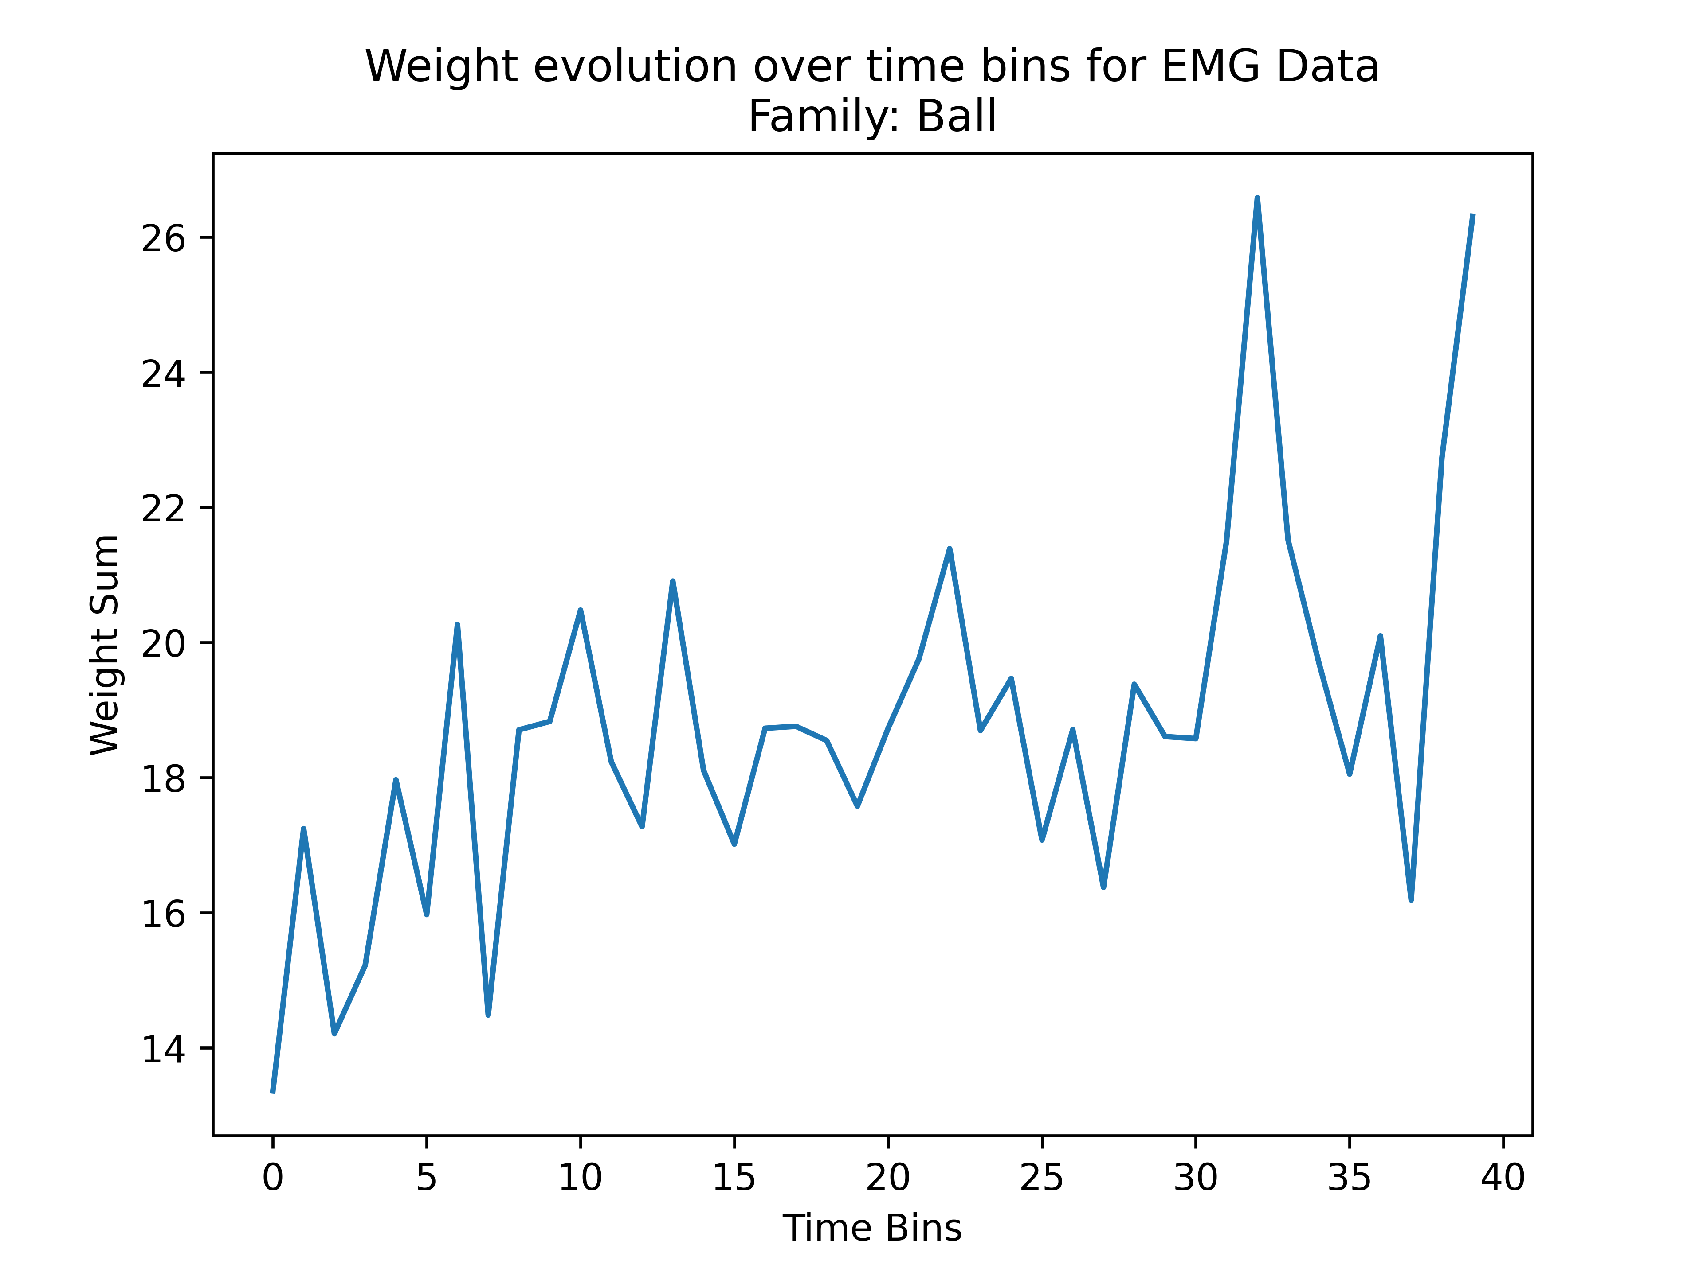
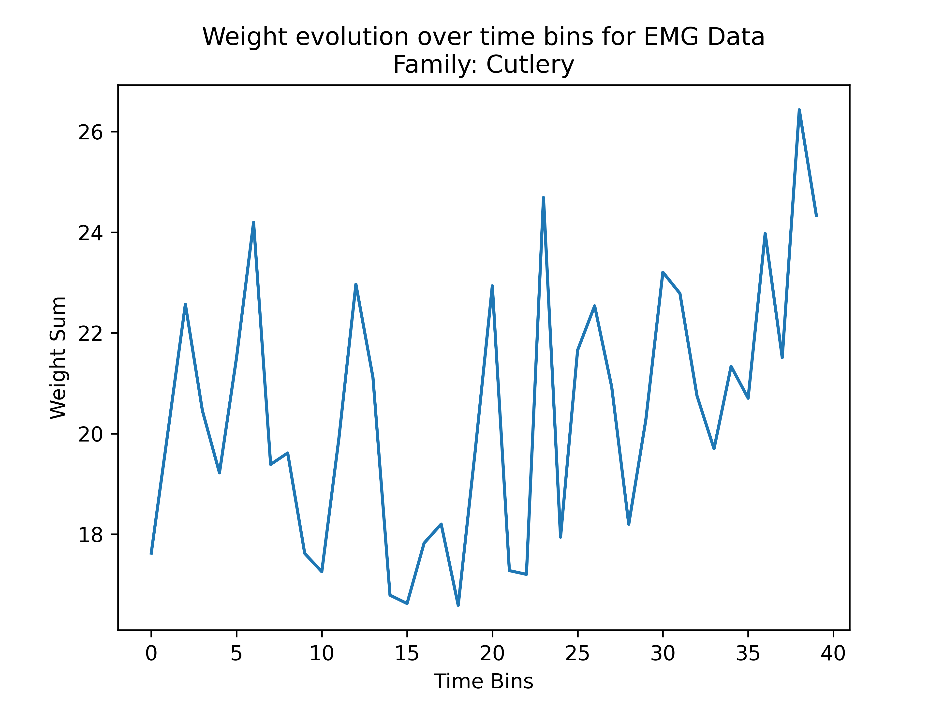
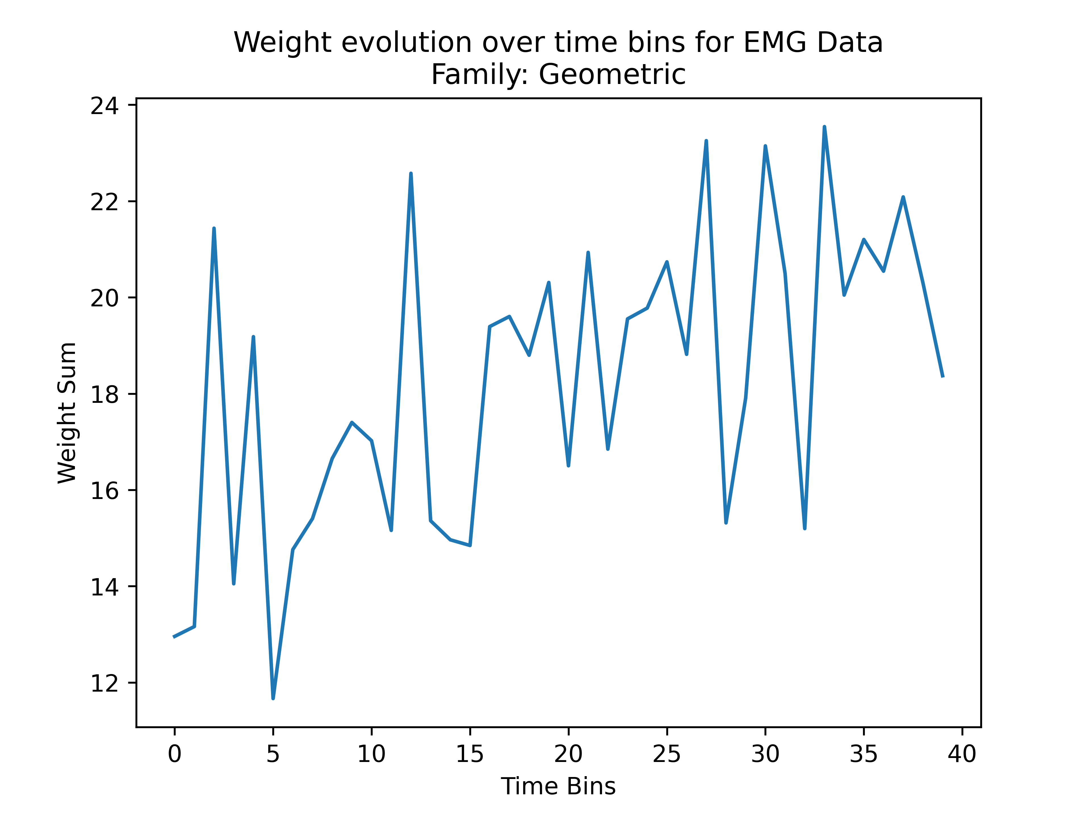
Analysis of weights

Slide 37
Analysis of weights
For Kinematic Data “Thumb MPJ” and ”Thumb IJ” show high weights for all families.
For EMG data “Extension” sensors show higher weights than “Flexion” sensors.
Both Kinematic and EMG data show an increase in weight towards the end of the Exploratory Procedure.
No analysis for Tactile data and its combinations with previous sources.

Slide 39
Object Classification based on the Exploratory Procedures used by the Subject

Slide 40
Object Classification by EP “sequence”
…
rotation
enclosure
EP 1
1 | 0 | 1 | … | Obj A
0 | 0 | 1 | … | Obj A
0 | 1 | 1 | … | Obj B
EP 2
EP n
We encode the presence/absence of each EP during a particular trial in a binary vector and use that vector to predict the object.
The accuract using this approach is 48.26%.
Because now our variables are the EPs we can take a look to the model weights to find which EPs are the most significant.

Slide 41
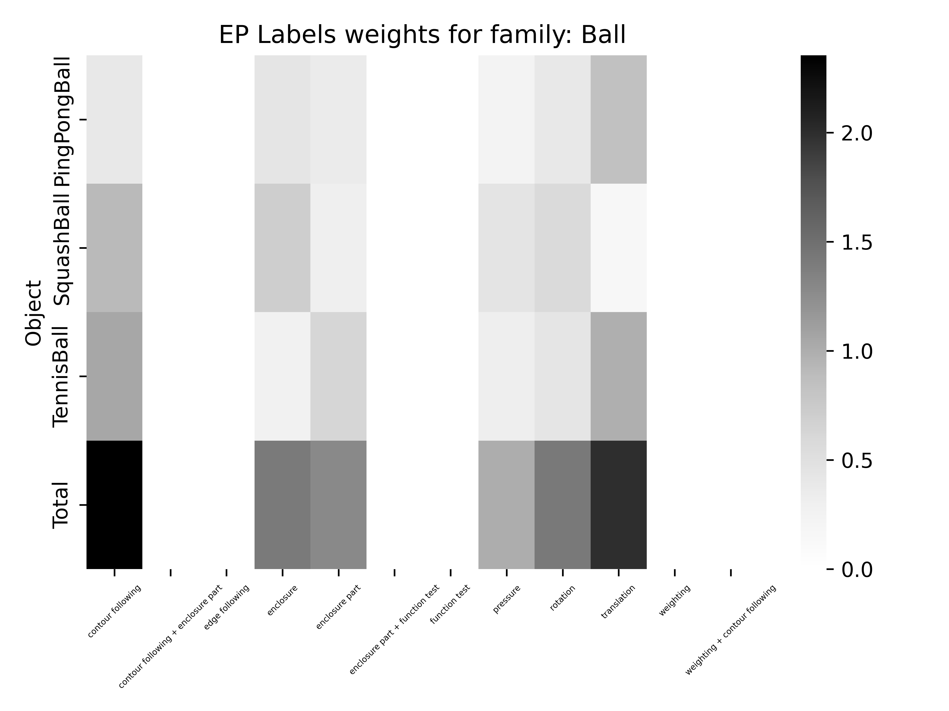
Weights for Object Classification by EP “sequence”
Accuracy: 39.39 %

Slide 42
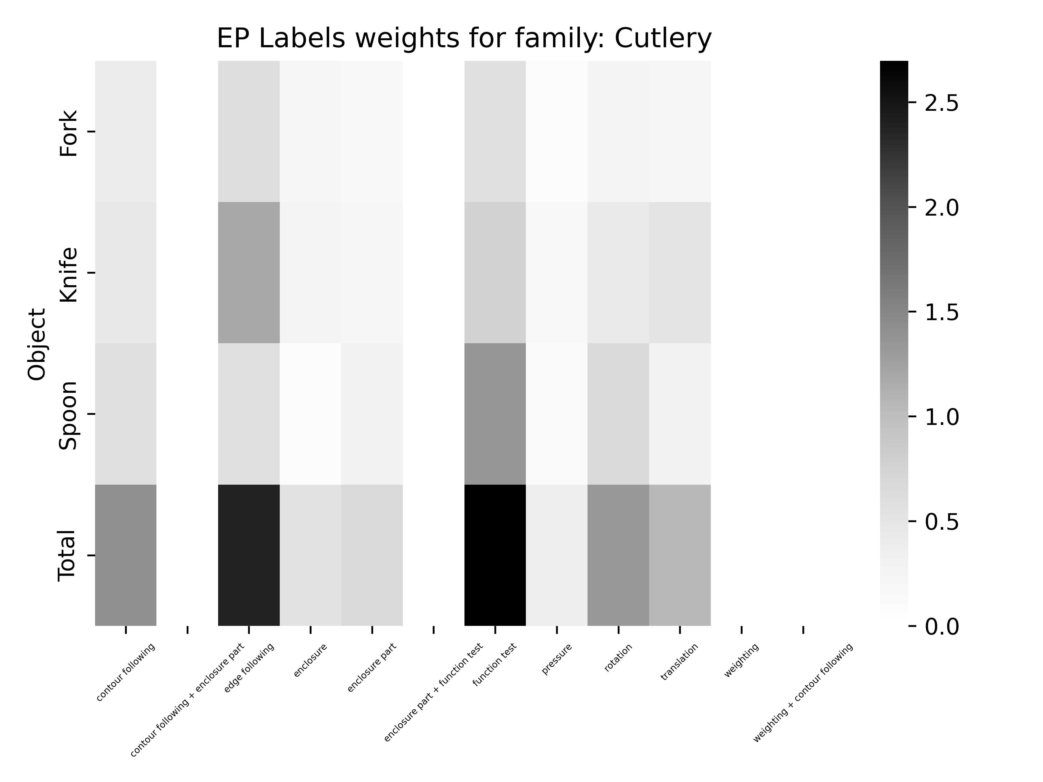
Weights for Object Classification by EP “sequence”
Accuracy: 54.55 %

Slide 43
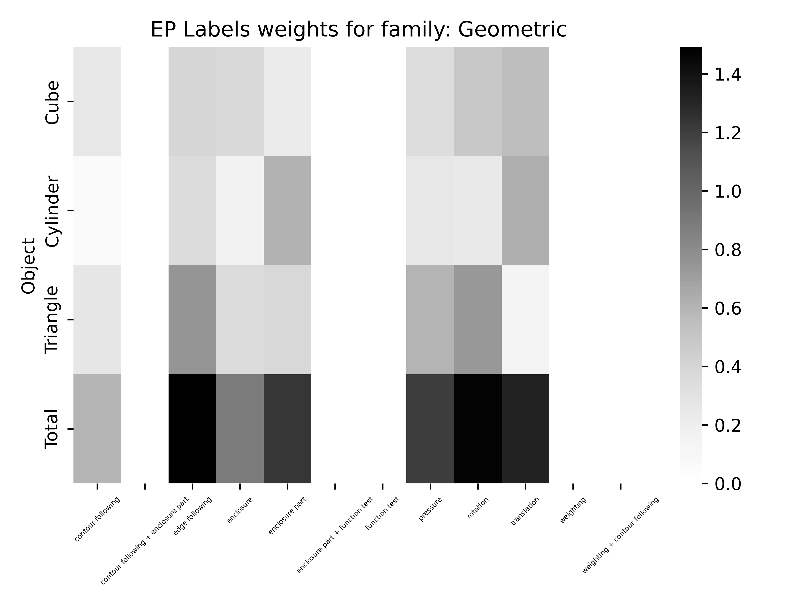
Weights for Object Classification by EP “sequence”
Accuracy: 38.38 %

Slide 44
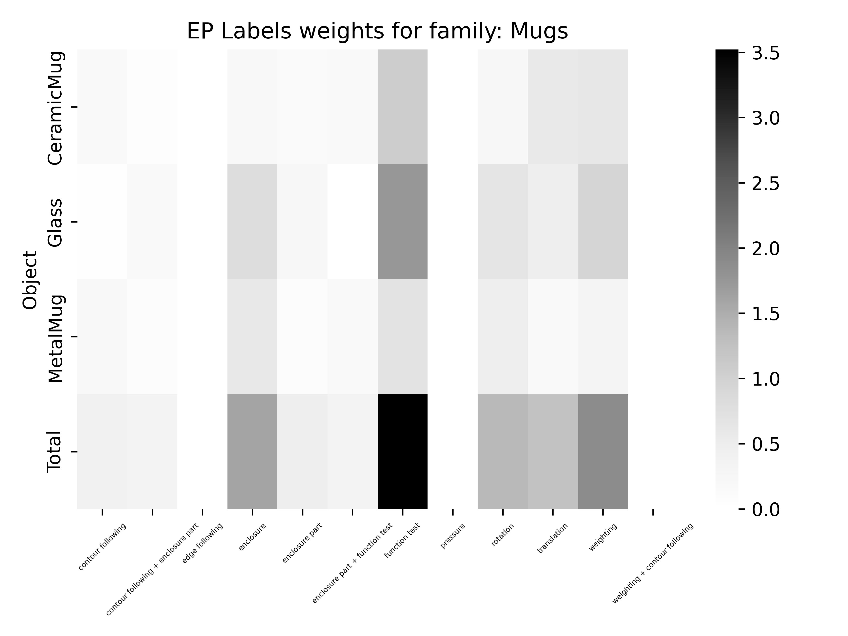
Weights for Object Classification by EP “sequence”
Accuracy: 50.5 %

Slide 45
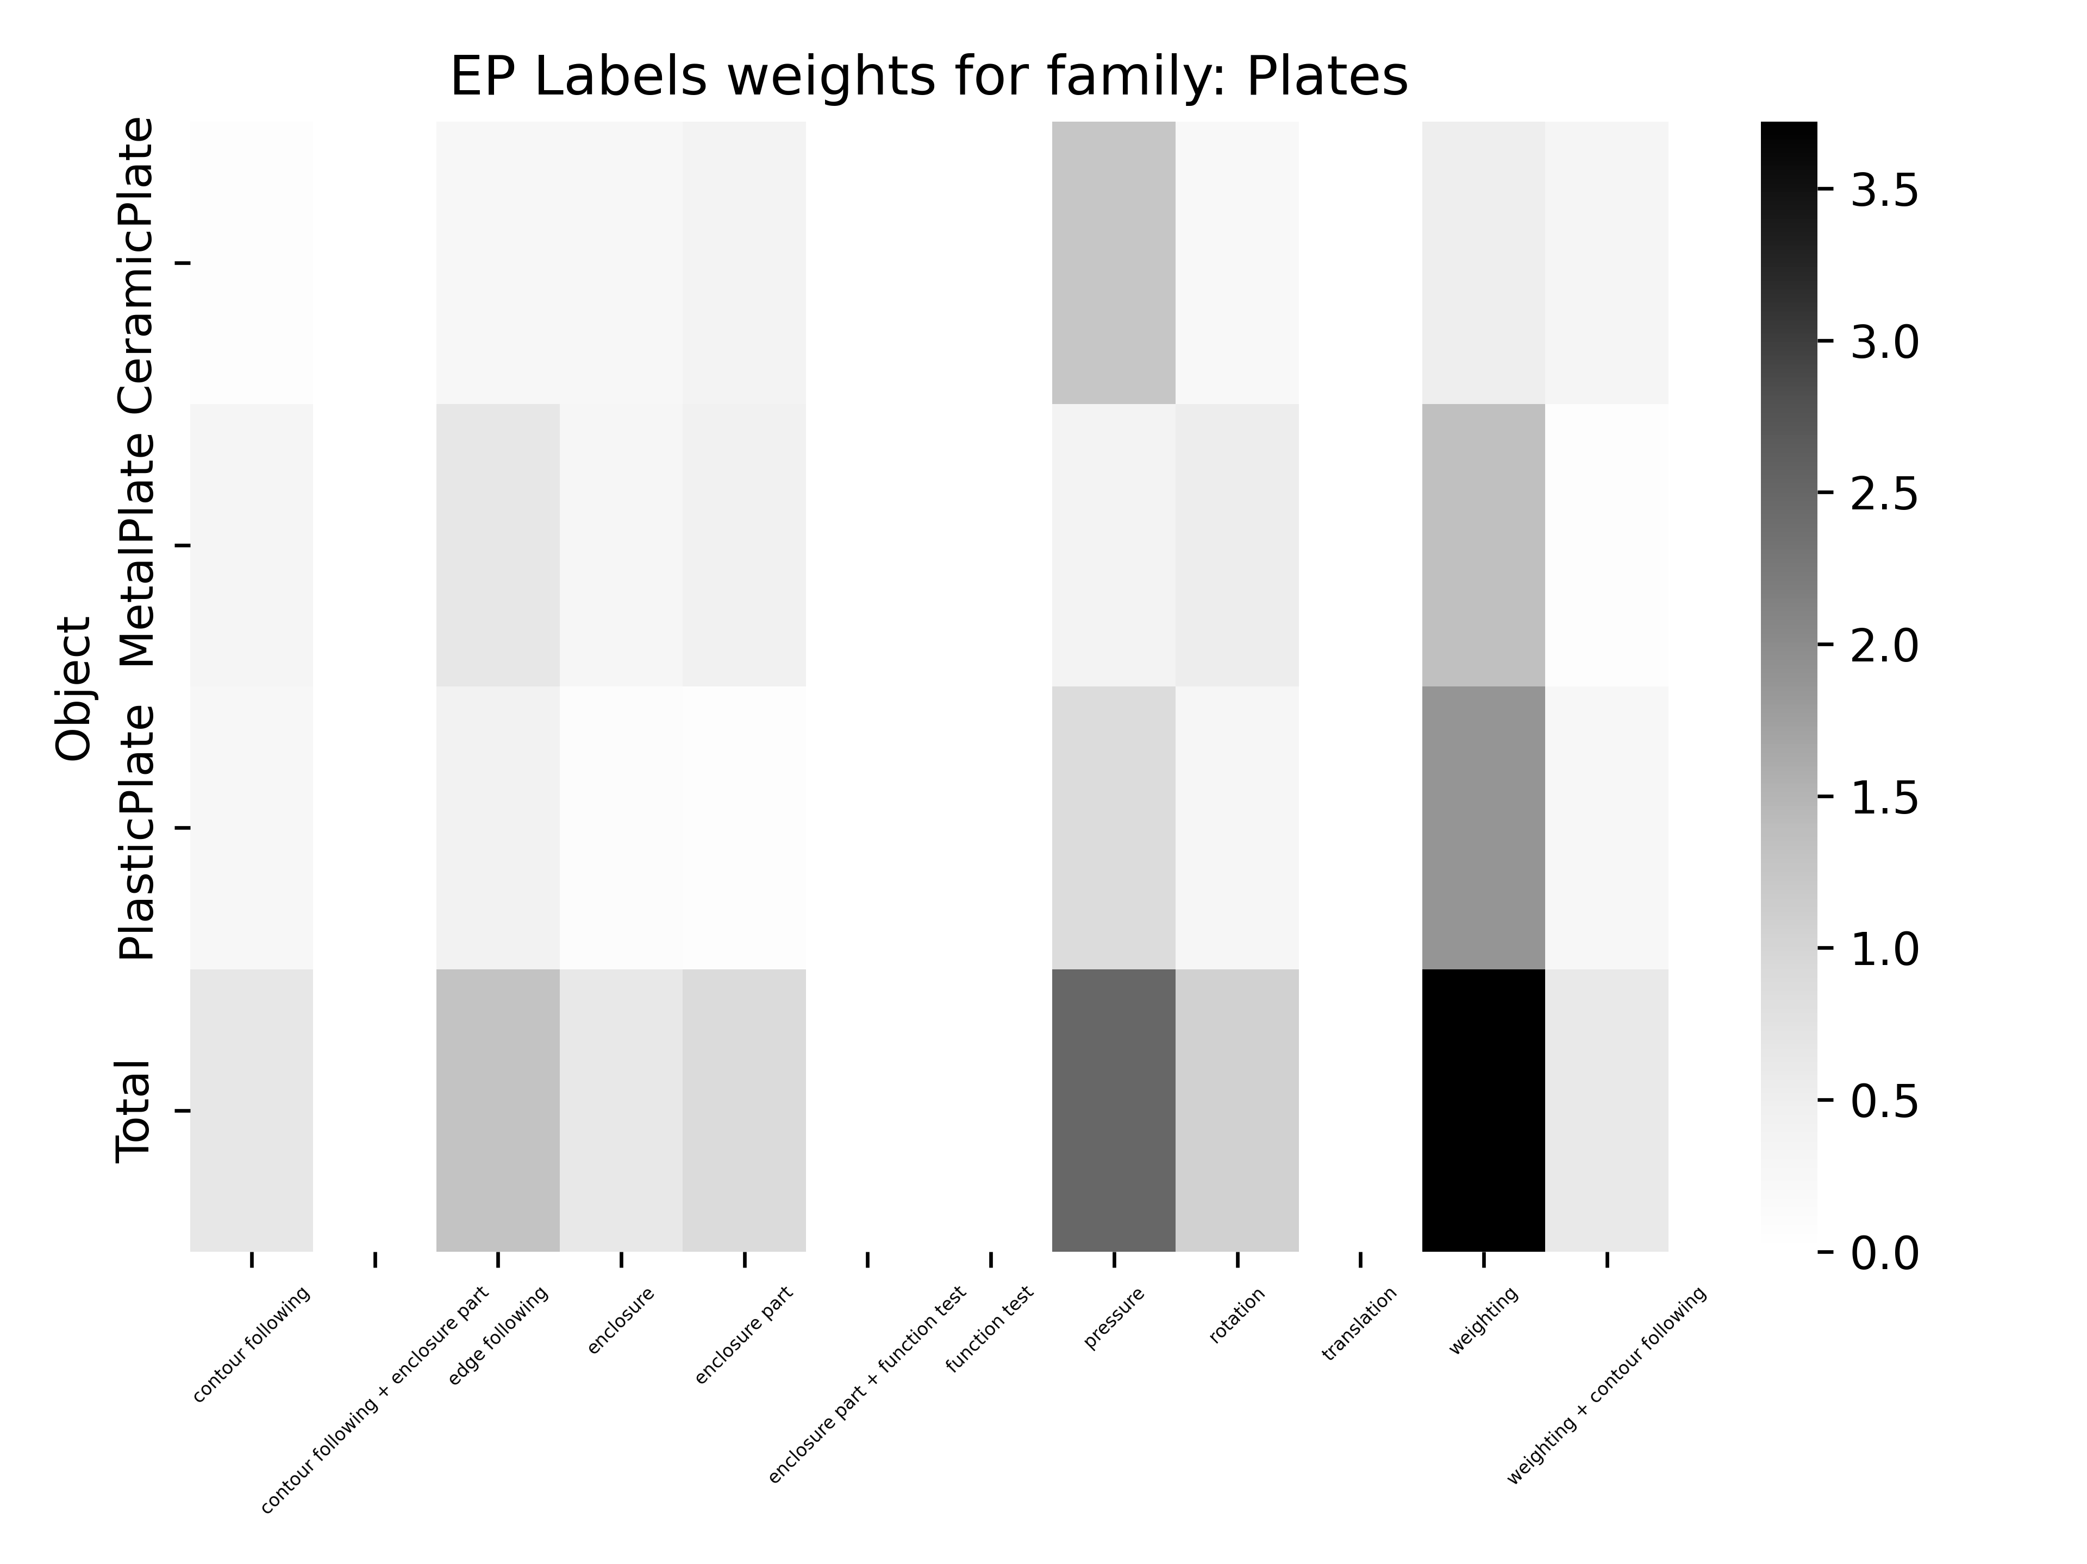
Weights for Object Classification by EP “sequence”
Accuracy: 58.59 %

Slide 47
Future Work
Perform same classification but using those synergies extracted from a dimensionality reduction technique such as PCA or NMF.

